Slide 1
Search Engines
Elasticsearch, OpenSearch and Sphinx
12/2024
Alfio Cardillo - ID: 000605069,
Josu Bernal - ID: 000605785,
Ignacio del Rio - ID: 000607231,
Charlotte Garcia- ID: 000614721,
Nicola Mambelli - ID: 000612421,
Jule Grigat - ID: , 000612661

Slide 2




Structure
Introduction to Search Engine technology
Presentation of Elastic Search, Sphinx and OpenSearch
Benchmarking
Proposed Applications and Interesting Research

Slide 3
Introduction to Search Engine technology

Slide 4
What is a Search Engine?
A specialized database designed for retrieving information from stored documents.
Key elements: documents, attributes (e.g., title, author), and information stored as unstructured text.

Slide 5
Search Engines vs. Relational Databases
Search engines handle unstructured text, unlike relational databases.
Designed for full-text search and ranking based on relevance.

Slide 6

Search Engines vs. Relational Databases
Main differences
Effective Indexing
Search engines create inverted indexes to map words to documents, enhancing text search performance.
Relational databases use B-trees or hash indexes for structured data lookups.
Performance Optimization
Search engines use caching, distributed systems, and relevance algorithms for efficient large-scale querying.
Relational databases are optimized for transactional integrity and fast updates within smaller datasets.

Slide 7
Conceptual Challenges in Search Engines
Inherent Problems when retrieving information
Relevance
Evaluation
Context understanding
The significance of a document based on the query provided by the user
Not always just based on matching words, but on context (ex: concert tickets for the current year)
Extracting the essence of a document
No definitive correct solution for every query
Methods to determine the quality of the provided information needed
Testing the effectiveness using pre-labeled databases or user feedback
Understanding the underlying information of the users queries (ex: Python: animal or language)
Techniques such as query suggestion, query expansion, and relevance feedback

Slide 8
Technical Challenges in Search Engines
Challenges when implementing a search engine
Performance
Adding new Data
Scalability and Adaptability
Technical set up to minimize query runtime
Due to the Index implementation, adding new Data requires effort
Depending on the purpose of the search engine its scalability is important.

Slide 9
Architecture of Search Engines
Text Acquisition
Text Transformation
Index Creation
User Interaction
Ranking
Evaluation

Slide 10
Text Acquisition
Text Acquisition
Text Transformation
Crawling
Discovering and collecting documents or data from various sources.
Feeding
Transferring the collected data into the search engine's database and transforming it to be processable.
Index Creation
User Interaction
Ranking
Evaluation

Slide 11
Text Transformation
Text Acquisition
Text Transformation
Parsing and Tokenization
Breaks text into tokens, encoding syntax and structural details (e.g., title words).
Stop-Word Component
Filters out common words (“the,” “and”) to improve indexing efficiency.
Streamer and Classifier
Grouping similar words based on morphology or topic.
Optional Additional Components
Retrieving special text (e.g. custom dictionaries for specialized fields of use).
Index Creation
User Interaction
Ranking
Evaluation

Slide 12
Index Creation
Text Acquisition
Text Transformation
Document Statistics
Gathers data about words and documents to calculate word importance and weights.
Inverted Indexes
Lists words and their weights,
optimized for updating and compression.
Updateability
When adding new documents and words the indexes (including the weights) have to be updated.
Optional Distributed Indexes
Enables parallel querying and processing across multiple computers.
Index Creation
User Interaction
Ranking
Evaluation

Slide 13
User Interaction
Text Acquisition
Text Transformation
Query Analysis
Takes user queries as input, corrects errors, and expands them to improve search outcomes.
Input Enhancement
Refines input for more relevant search results.
Optional Search customization
Provides specialized search Operators for more complex search queries
Index Creation
User Interaction
Ranking
Evaluation

Slide 14
Ranking
Text Acquisition
Text Transformation
Ranking functions and scores
Defines how scores for results are calculated and optimized.
Optional Horizontal Distribution
Uses query brokers and caching to speed up and improve performance.
Index Creation
User Interaction
Ranking
Evaluation

Slide 15
Evaluation
Text Acquisition
Text Transformation
Performance Analysis
Monitoring engine relevance and accuracy via various metrics.
Evaluation Methods
Includes user interaction feedback, prelabeled document rankings, and component monitoring.
Index Creation
User Interaction
Ranking
Evaluation

Slide 16
Elasticsearch

Slide 17
Introduction to Elasticsearch
Distributed and Scalable Search Engine ​
RESTful search and analytics engine built on Apache Lucene.​
scale horizontally across multiple nodes
high availability and performance for large datasets
Real-Time Search
real-time indexing and querying
near-instant retrieval of data and efficient data analysis
Querying and Aggregations
advanced full-text search capabilities
aggregation for complex data analysis
support for custom analyzers

Slide 18

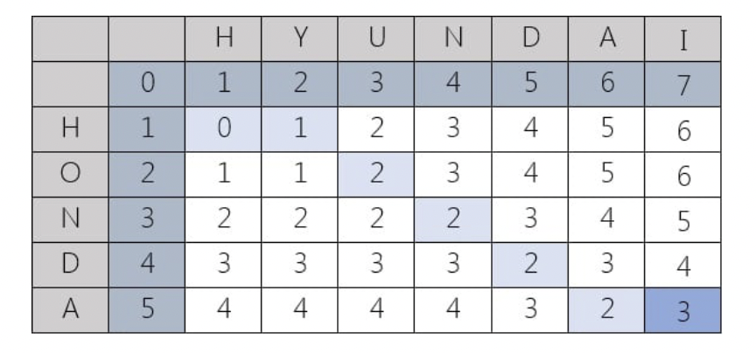
Introduction to Elasticsearch
Open-source search index
Use of inverted indexing to map words to the documents in which they appear
Expands the concept of a search index on full text (ex: Levenshtein distance)
Built on Apache Lucene

Slide 19
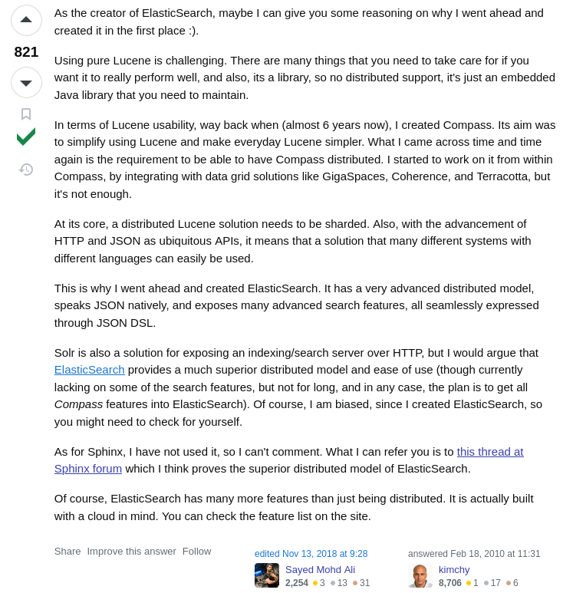
Why Elasticsearch
Created by Shay Banon
Born on top of Lucene, as Banon said Lucene was
Hard to use
Non distributed

Slide 20
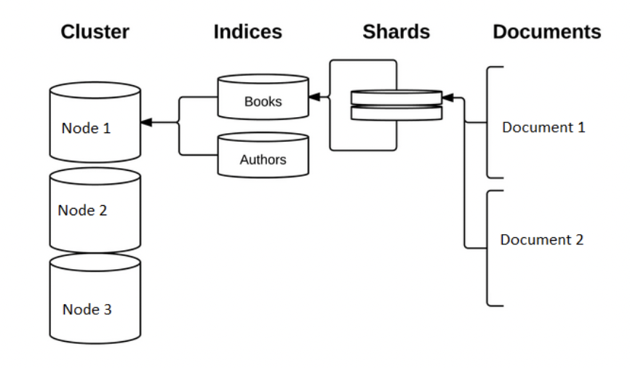
Elasticsearch Architecture
Main components:
Clusters
Nodes
Ports
Index/Shards
Replicas
Analyzers
Documents
REST API

Slide 21
Architecture of Elasticsearch
Clusters and Nodes
Clusters
Nodes
Categories of Nodes
Collection of nodes that together hold all the data
Provide search and indexing capabilities across all nodes
Ensures that data and load is distributed across the nodes
Able to scale horizontally
Single instances of Elasticsearch
Belongs to a specific cluster, identified with a unique id
Responsible for storing data and participate in the cluster’s indexing and search capabilities
Master-elligible node: for cluster-wide actions (creating, deleting index...)
Data Node
Ingest Node: for pre-processing pipelines
ML Node
Transform Node

Slide 22
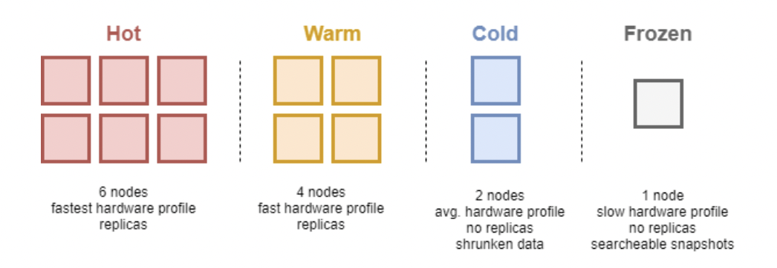
Architecture of Elasticsearch
More on Nodes
Every cluster must have one master and at least a data role,
Node can have multiple roles
Clusters of just a node are possible
Data Nodes
Hold the shards and handle data with search and aggregation operation
Scale of such nodes takes the name from temperature
Nodes of high temperature requires more and faster resources like SSDs

Slide 23
Architecture of Elasticsearch
Index/Shards
Ports
Replicas
Index is similar to a database in relational schema
Divided into shards, individual instances in Lucene
2 ports to communicate with HTTP requests and between nodes
Replica shards are copies of primary shards
Ensure conservation of data
Analyzers
Documents
REST API
What takes text and breaks it into tokens
Tokenizer and possible sets of filters
JSON objects
Defined by a set of fields
Schema-less
Allows interactions through HTTP requests

Slide 24
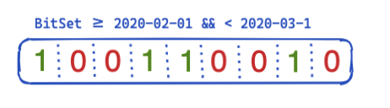
Caching
A bitmap records what documents a certain condition hits, and puts a 1 if that document is retrieved.
Allow bitwise operations like AND or OR, to understand when a document matches several conditions.
Query caching: cache parts of the query that are very common or popular for later use
Provides better information retrieval

Slide 25
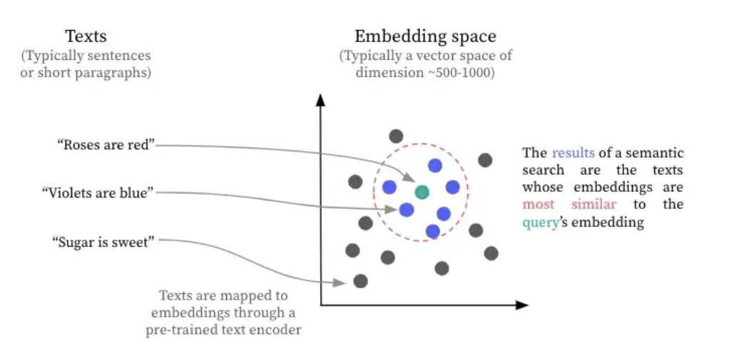
Semantic Search
Create for each paragraph, phrase or word, an embedding (typically a vector representation of that text)
Uses a text encoder trained on textual similarity
Vectors of similar phrase will have a short distance between one and another
"data searching technique
that focuses on understanding
the contextual meaning and intent behind a user’s search query" *
*Vivien Tran-Thien, Semantic Search: An Overlooked NLP Superpower (https://blog.dataiku.com/semantic-search-an-overlooked-nlp-superpower)

Slide 26
ElasticSearch – Advantages and Disadvantages
Advantages
Scalability
Semantic Search
Performance
Integration
Distributed architecture
Scales horizontally and easily extendable
Great semantic search capabilities powered by vector embeddings
Efficient caching mechanisms for faster
query execution.
REST API for
interaction with
other systems
Disadvantages
Licensing Restrictions /Costs
Resource-Intensive
Complex Setup
Requires subscription for more advanced use
High memory and storage requirements for large-scale implementations.
Requires expertise for optimal configuration and maintenance.

Slide 27
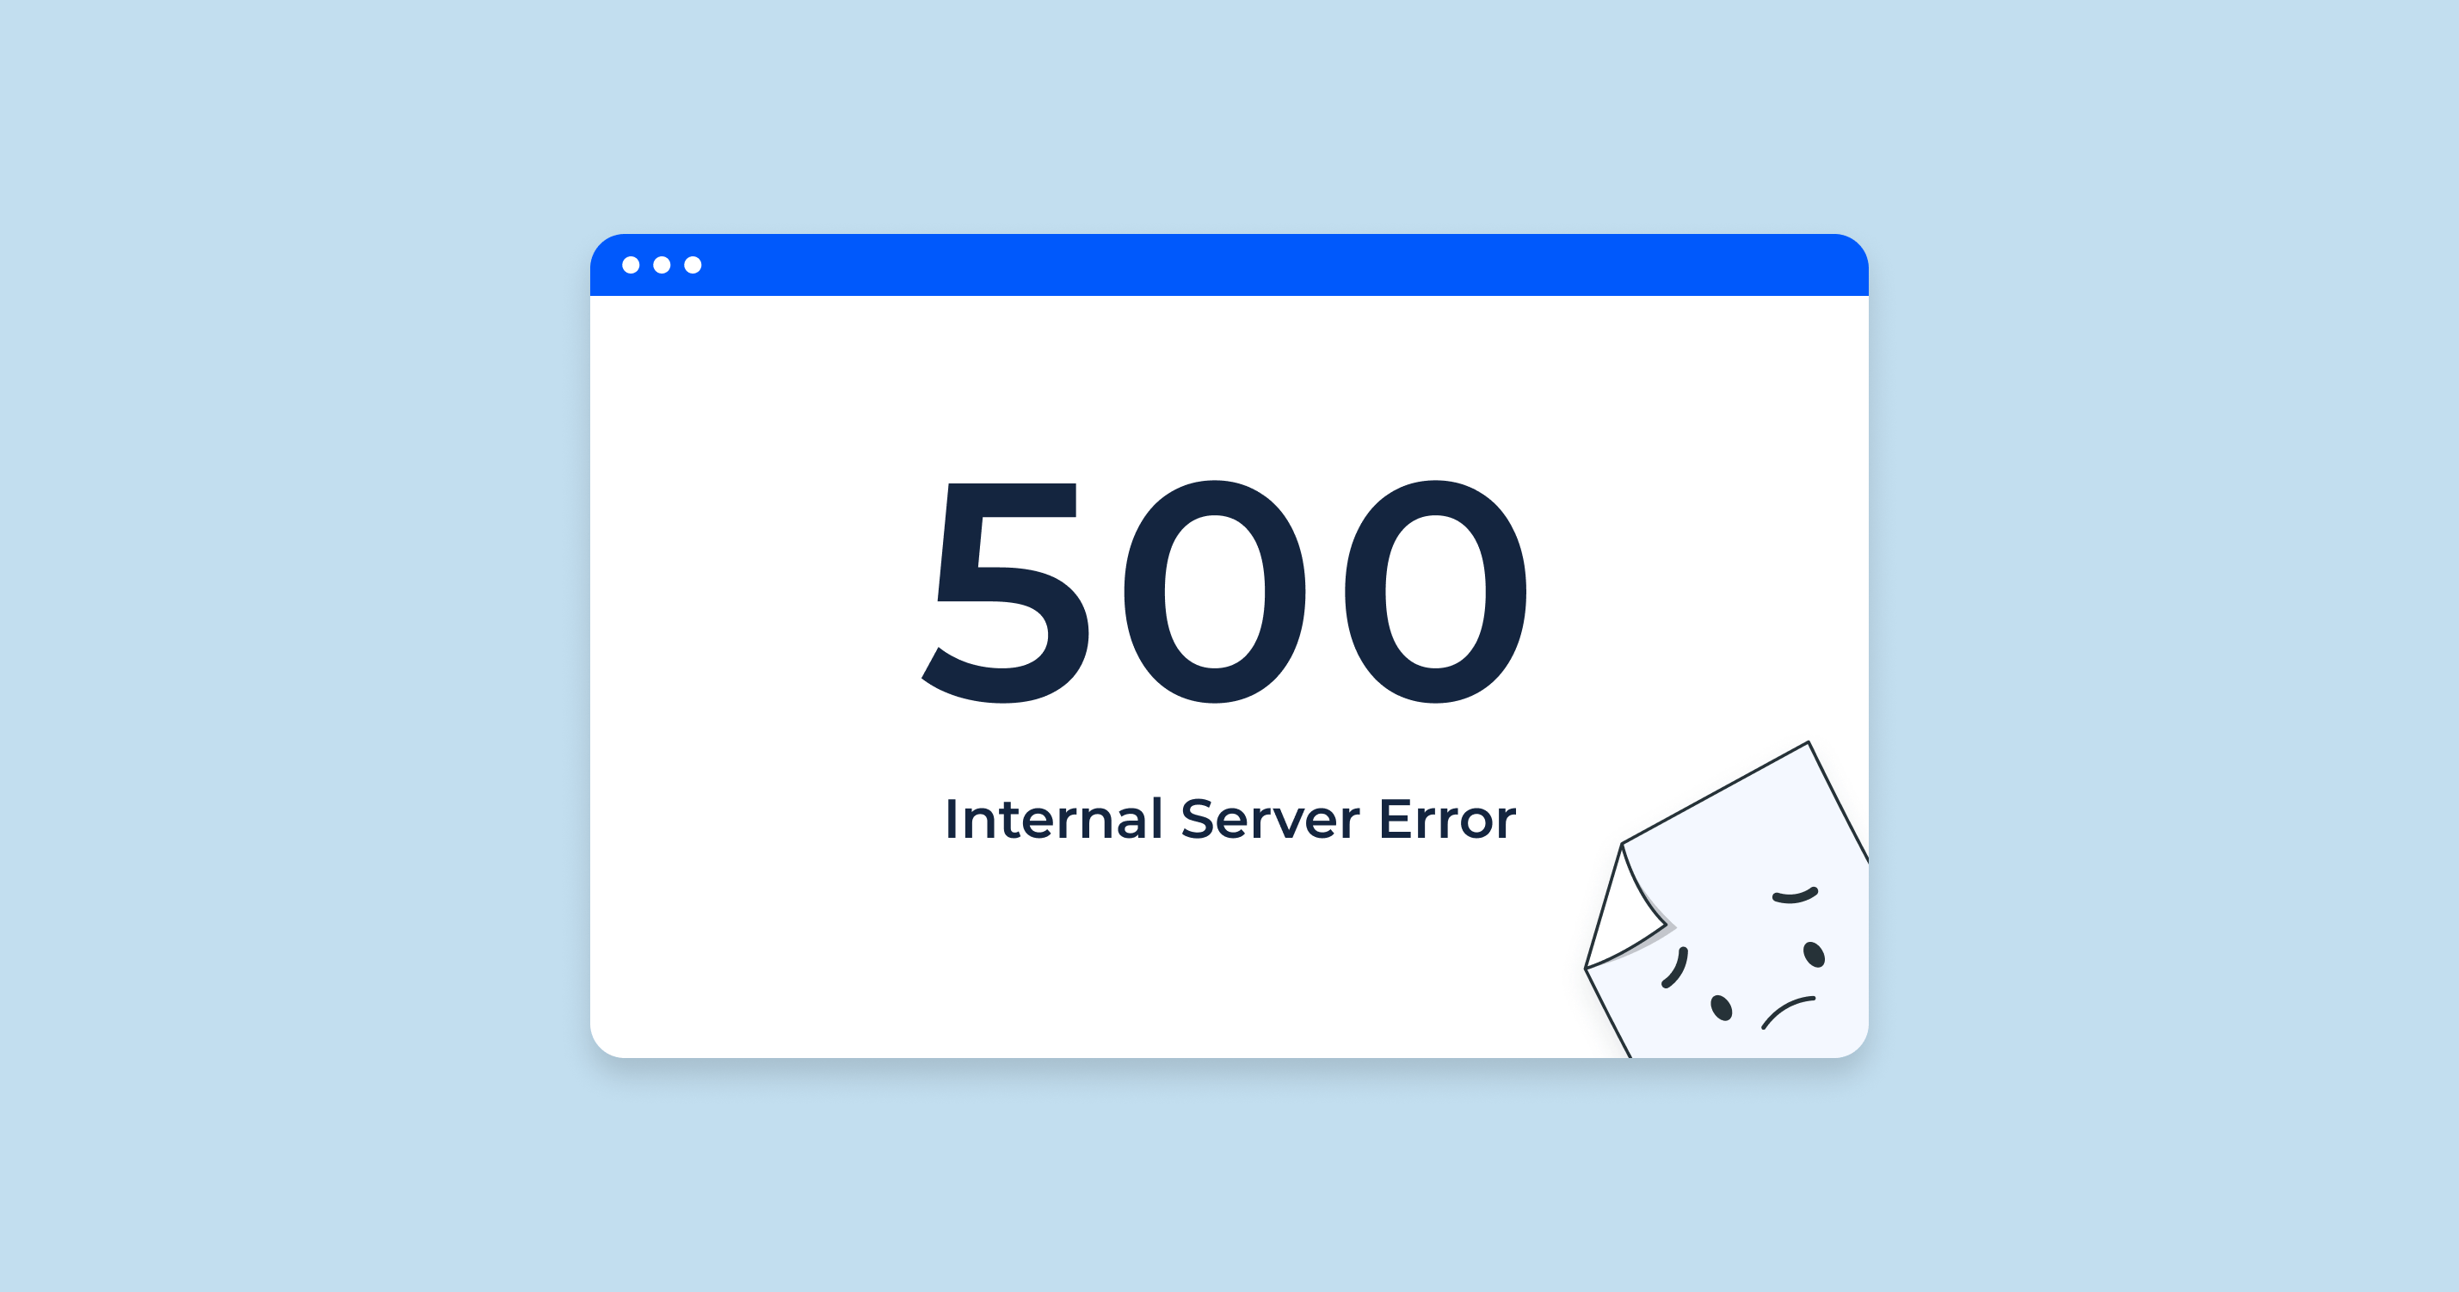
Difficulties
Logging is not informative
Issues when hard disk memory was not enough, or was under a threshold
Nodes crashing with no apparent reason, when inserting new data

Slide 28
Sphinx

Slide 29
Introduction to Sphinx
Full-Text Search
Open-source search engine designed for fast and efficient full-text searching
Capable of handling large volumes of data with high query performance.
SphinxQL Interface
Uses SphinxQL, a SQL-like query language
Easier for users familiar with SQL to use
Real-Time and “Disk Indexing”
Supports both real-time and offline indexing depending on the data source type

Slide 30
Key Features in Sphinx
Near-Real-Time and offline indexing
Efficient querying via multiple APIs (SQL, HTTP/JSON, native SphinxAPI ).
Full-text and non-text searching
Relevance ranking, from basic formulas to ML models
Results retrieved from multiple servers
Support for morphological text processing and geosearch.

Slide 31
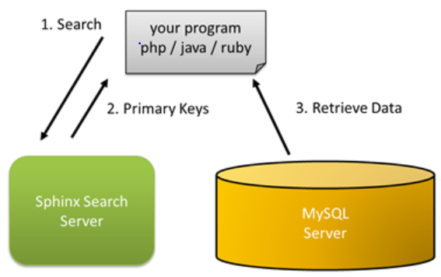
Sphinx Architecture
Structure of Sphinx components
Very simple structure with a standalone Search Deamon
→ No direct connection to database
https://sphinxsearch.com/docs/sphinx3.html#indexes
Search Query – Provided by the User
Primary Keys – Pointing to documents containing search words
Retrieve Data – Output ranked documents from various data sources

Slide 32
Architecture of Sphinx
Text Acquisition
Text Transformation
Dual Indexing
Use of various data sources
Connectable to existing real-time data sources like MSQL Servers
Standard text normalization
Stemming, lemmatization, morphology, stop words
Happens during index creation
“Disk Index” – static data sources
Real-Time Index – dynamic sources
Adjustable per data source
User Interactions
Ranking
SphinxQL
Sphinx API Library
HTTP/JSON Interface
Exact word matching
Attribute weighting
Proximity matching
Customizable ranking functions

Slide 33
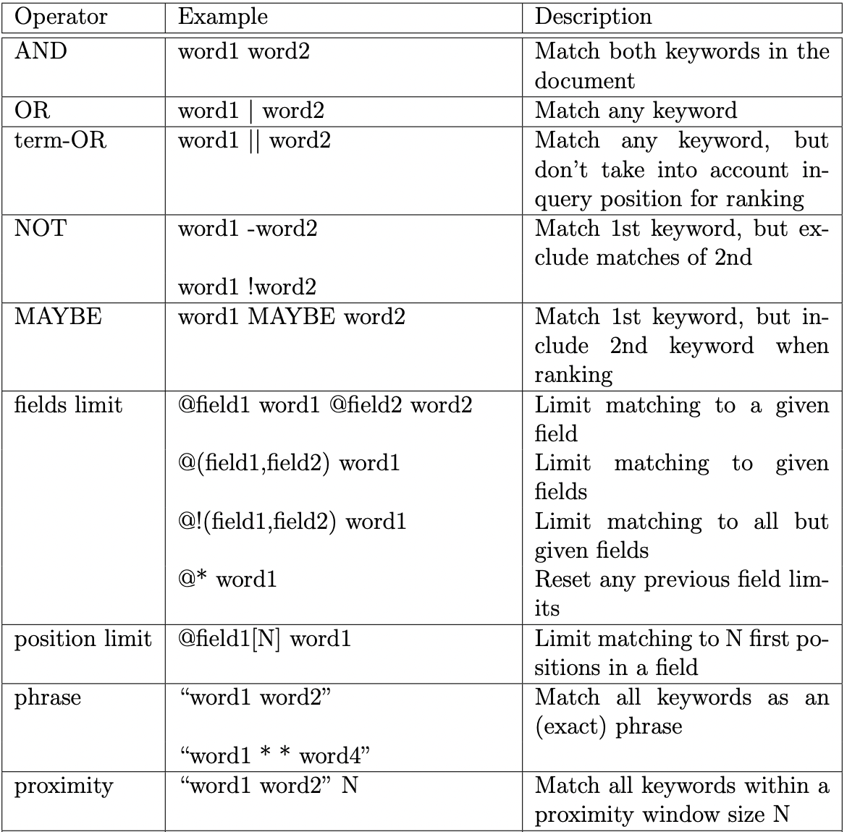
Querying and Syntax
Some available operators in SphinxQL
SphinxQL is a SQL dialect

Slide 34
Querying and Syntax
Limitations of SphinxQL compared to SQL
WHERE clause
SELECT
WHERE clause only accepts for column checks basic math comparison operators and BETWEEN, IN and NOT IN operators.
SphinxQL documentation explains some workarounds to manage more complex comparisons.
SELECT always has an implicit ORDER BY and LIMIT clauses based on the
weight of each document on the ranking (ORDER BY WEIGHT() DESC, id ASC LIMIT 20)

Slide 35
Sphinx – Advantages and Disadvantages
Advantages
Dual Indexing
SQL-Like Syntax
Incorporability
Runtime
Performs (near) real-time and offline indexing
→ Ideal for various use cases.
SphinxQL makes it accessible for developers familiar with SQL databases, although it still differs to an extent.
Can be connected to existing databases and requires fewer resources than other tools.
Very fast runtime due to “disk” indexing on static data
Disadvantages
Scalability Limitations
Feature Gaps
Smaller Community and Ecosystem
Not as scalable or distributed as Elasticsearch/OpenSearch.
Lacks advanced features like semantic search and vector embeddings.
Rather small user base with limited support and resources
Few integrations and no broad ecosystem

Slide 36
OpenSearch

Slide 37
Introduction to OpenSearch
Open-Source Search and Analytics Engine
Open-source, distributed search and analytics engine Scalable solution for text search and log analytics
Created in early 2021 after Elasticsearch 7.10.2 became licensed under Elastic’s SSPL (Server Side Public License), not OSI-approved.
Apache 2.0 licensed fork maintained by Amazon Web Services (AWS) and the community.
Elasticsearch Compatibility
Retains compatibility with Elasticsearch 7.10.2
Easy to migrate and integrate with existing Elasticsearch setups

Slide 38
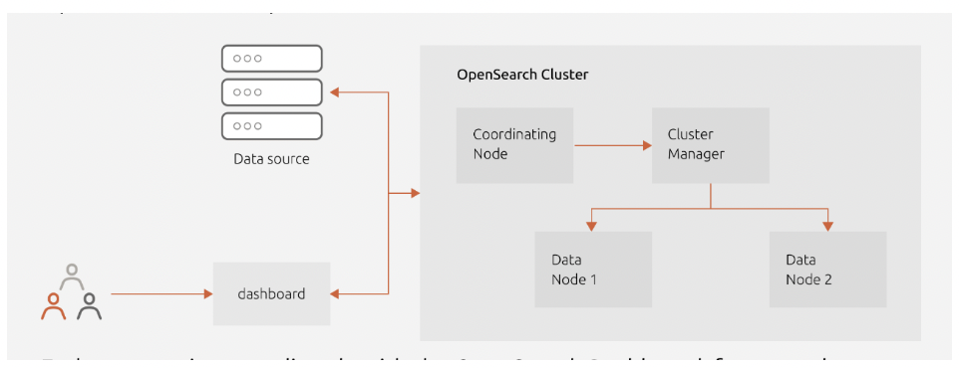
OpenSearch Architecture
Structure of an OpenSearch cluster
Very similar to ElasticSearch
Both built on Apache Lucene
Clusters with Nodes
Data stored in indices, split in shards (primary and replica)

Slide 39
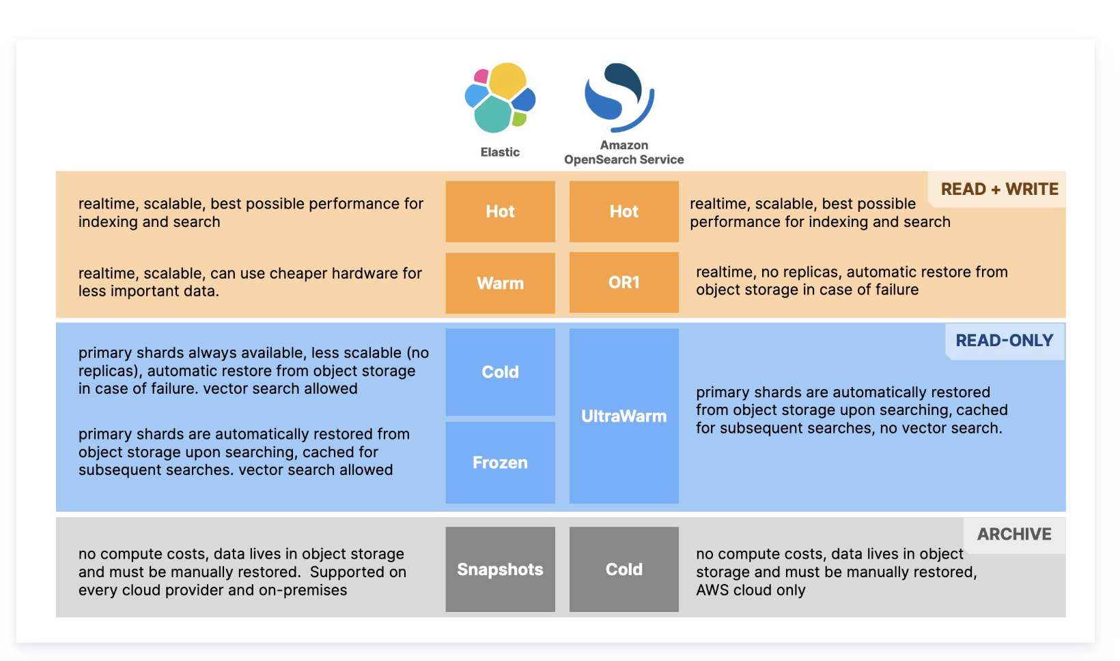
Architecture of OpenSearch
More on Nodes
Data Nodes
Different types of nodes: Cluster Manager Node (or Master Node), Data Node, Ingest Node, Coordinating Node, Dynamic Node (used for ML tasks) and Search node
As in ElasticSearch, Data Nodes have different types of data tiers
Representing distinct storage levels (based on criteria like access frequency, cost efficiency, and performance needs)
Ugo Sangiorgi. “Elasticsearch vs. OpenSearch: Vector Search Performance Comparison” (https://www.elastic.co/search-labs/blog/elasticsearch-opensearch-vector-search-performance-comparison)

Slide 40
Key Features in OpenSearch
Apache Lucene-Based
RESTful API Support for interaction with other systems using JSON.
Near Real-Time Indexing
Full-Text Search and Analytics: advanced text search capabilities, built-in support for aggregations, log analytics, and anomaly detection.
Visualization with OpenSearch Dashboards (fork of Kibana)
Vector Search: Built-in support for vector-based similarity searches, for applications like semantic search or recommendations.
Security Features: advanced security capabilities that don’t require a subscription (like in Elasticsearch).

Slide 41
Querying and Syntax
2 types of queries:
Leaf type
Full-text queries
Term-level queries
Joining queries
Compound type (wrappers for multiple leaf queries or compound clauses):
Boolean
Disjunction ...
Similar to ElasticSearch, in JSON

Slide 42
OpenSearch – Advantages and Disadvantages
Advantages
Open-Source
Compatibility
Search capabilities
Security
Fully open-source with an Apache 2.0 license and a growing set of plugins and a large community of users
Backward compatibility with Elasticsearch 7.10.2.
Supports modern search capabilities like vector-based semantic search.
Enhanced security features available out-of-the-box.
Disadvantages
Performance
Smaller feature scope
Smaller community
Slower performance than Elasticsearch, especially for vector-based searches.
Lacks the variety of plugins and tools available in Elasticsearch
Smaller community compared to Elasticsearch – fewer learning resources.

Slide 43
Benchmarking

Slide 44
Benchmarking
Official Benchmarking Discussion
ElasticSearch vs OpenSearch
Description and Database
Aplication with Relational
Our application

Slide 45
Official Benchmarking Discussion
Official Benchmarking Discussion
ElasticSearch vs OpenSearch
Two key metrics for evaluating search engines: performance and ranking.
Performance = speed of query processing
Ranking = comparing the results of query rankings against an established, pre-labeled ranking.
Decided to benchmark performance
Official benchmark cannot be applied to all 3 tools
Elastic Search is the most widely used search engine.
Many tools just focus on comparing different configurations of Elastic Search.
Huge difference between query syntaxes.
Description and Database
Application with Relational
Our application

Slide 46
ElasticSearch vs OpenSearch
Official Benchmarking Discussion
ElasticSearch vs OpenSearch
Comparing two related tools managed by different companys points out their individual strengths
Using the public database “geoname”
Using standard search engine queries
Basic search Queries
aggregation Queries
Sorting Queries
Special Queries: Painless static and Painless dynamic
Description and Database
Application with Relational
Our application

Slide 47
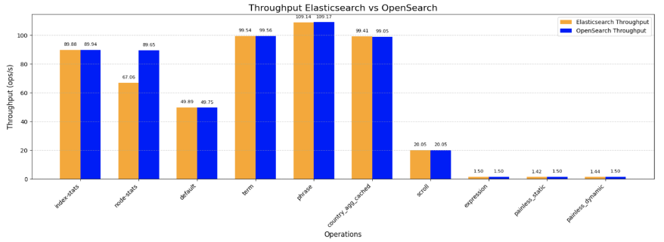
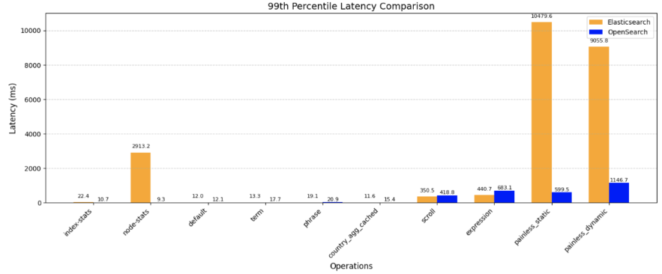
ElasticSearch vs OpenSearch Benchmark - results
Throughput - Workload on units of time
→ Comparable Operation Management
Latency - Response time of the tools from task arrival to actual execution
→ Elasticsearch performs faster in search or aggregation queries, which suggests it may be optimized for these types of operation

Slide 48
Description and Database used
Official Benchmarking Discussion
ElasticSearch vs OpenSearch
Comparing the 3 tools with SQL server
Stack Overflow database
Queries
Written 18 queries and translated them in the three languages
Some of these queries were not compatible with SQL Server
Description and Database
Application with Relational
Our application

Slide 49
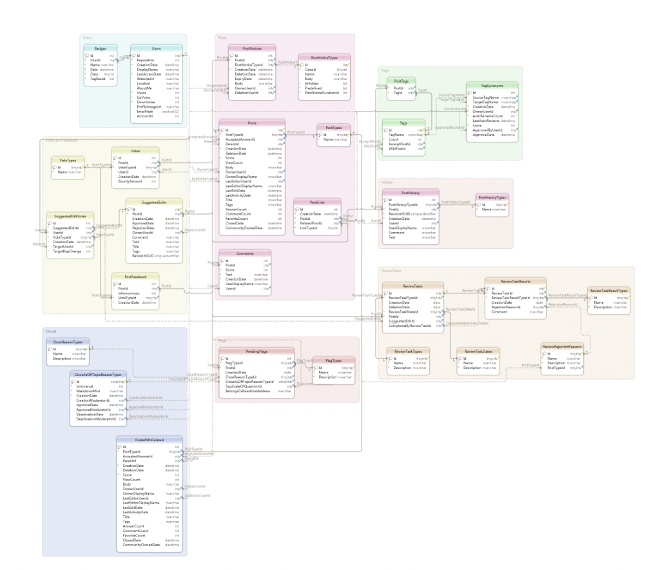
StackOverflow Database
Various versions of their
database, each containing
different amounts of data
For this benchmark, only
the fact tables Posts, Users and
Comments were used (only tables
containing full-text attributes)
Performed our own scaling (the ones
offered were too big for our machines)

Slide 50
Description of the setup – SQL and Sphinx
Dataset
Sphinx
SQL server
scaled the dataset down to perform comparisons between the performance of the tools with different workloads
Scale factors used in the
benchmarks are 1, 0.5 and 0.33.
Downloading and loading the database into MySQL
Wrote a configuration file that outlined the various indexes Sphinx should create and specified the data source
Created joined indexes
Reference of how a relational model would address these types of problems.​
​
Downloaded the technology, loaded the database, and used the default setup

Slide 51
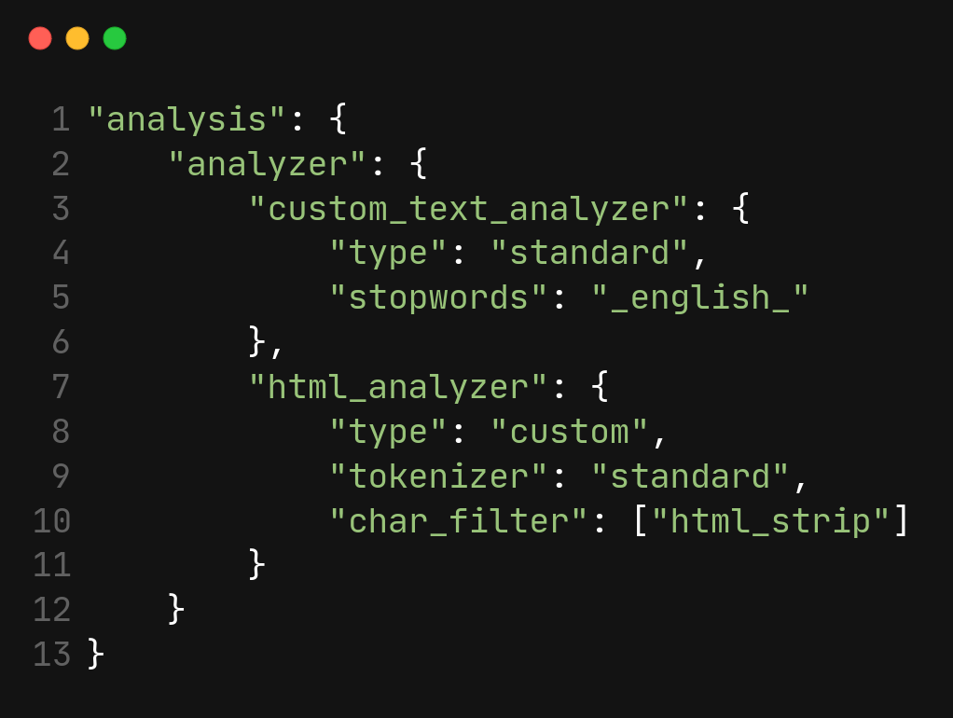
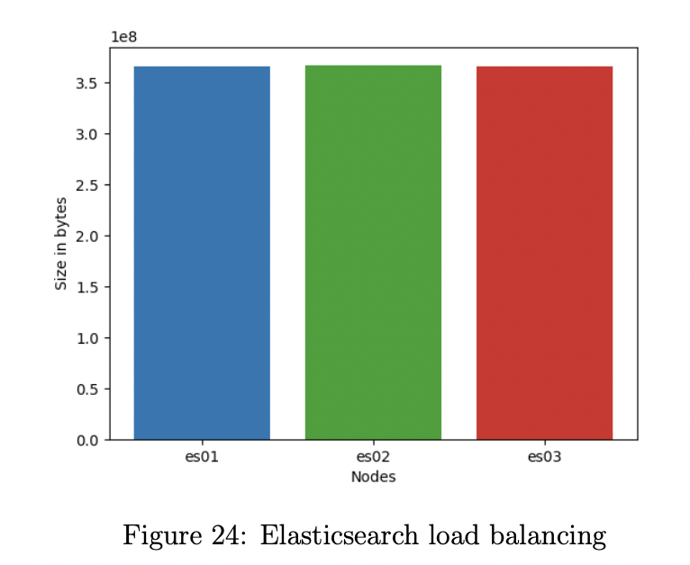
Description of the setup - Elasticsearch
Cluster
Analyzer
Made up of 3 nodes, all both master and data
Using a docker-compose, initialize them under the same network, assigns each of them a volume
Each index has 5 shards and 0 replica
If want more resilience, can add replicas
Ex: posts index is divided into 6 shards
Two analyzers, one for the normal text and the other for the body of the posts
Body of the posts stored as html contents (don't want to index it)

Slide 52
Description of the setup - OpenSearch
Creation of a Docker image to run the database system.
The benchmark was designed to run locally. Scales factor used 1x, 0.5x, and 0.3x.
Creation of the Join indexes before the queries
In total 15 different indexes were created

Slide 53
Ran every query just once Main purpose was to compare search engines against relational database systems Results with times for each query for the different database scale factor
Official Benchmarking Discussion
ElasticSearch vs OpenSearch
Application with Relational
Description and Database
Application with Relational
Our application

Slide 54
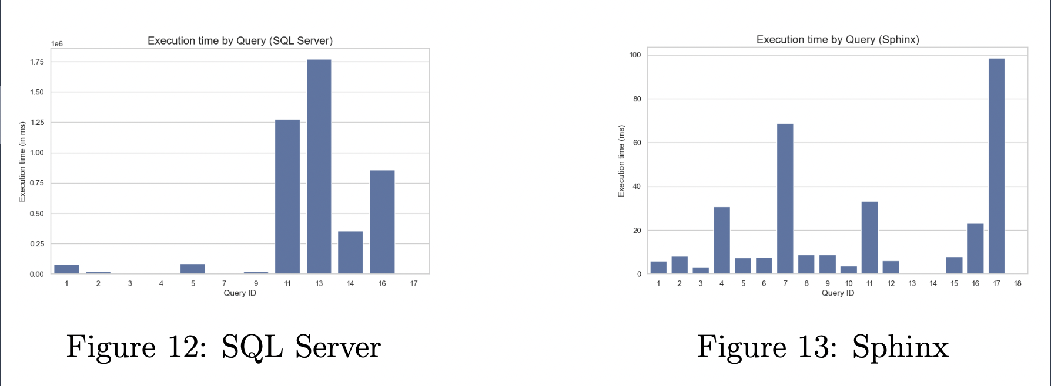
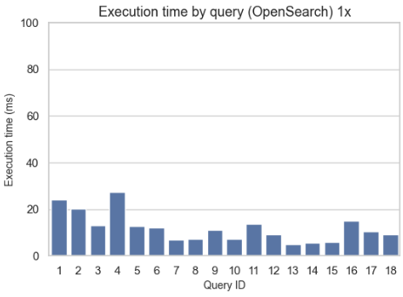
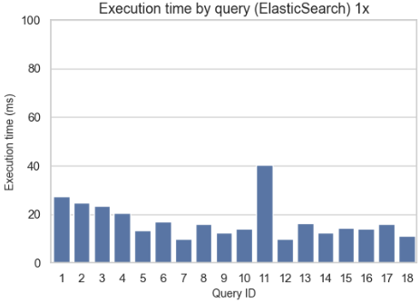
Application with relational - results
Scale factor : 1
The difference is really big between
the search engines and the relational
system.
SQL Server took 74 minutes and 34
seconds to execute all the queries, while
Sphinx only took 0.3 seconds

Slide 55
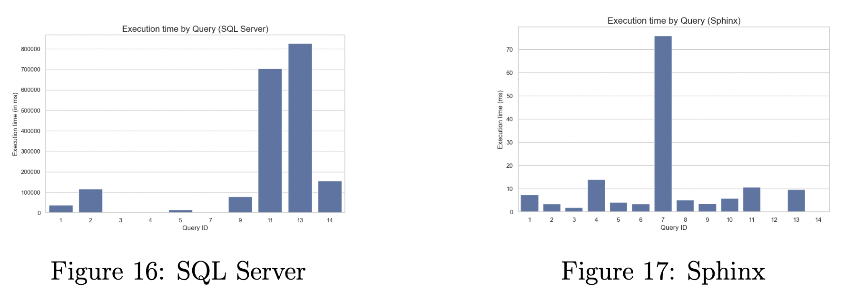
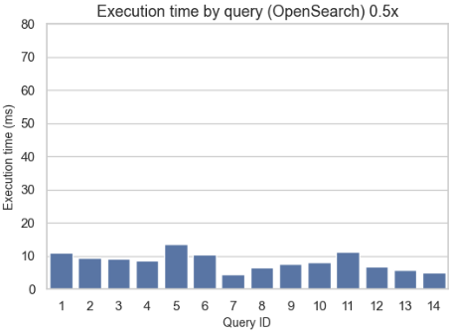
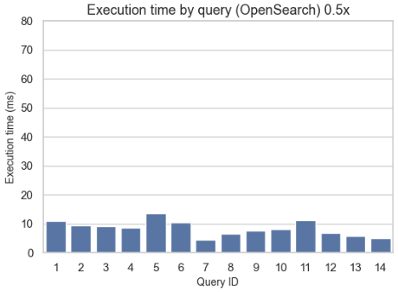
Application with relational - results
Scale factor : 0.5
SQL Server executed all queries
in 32 minutes and 26 second

Slide 56
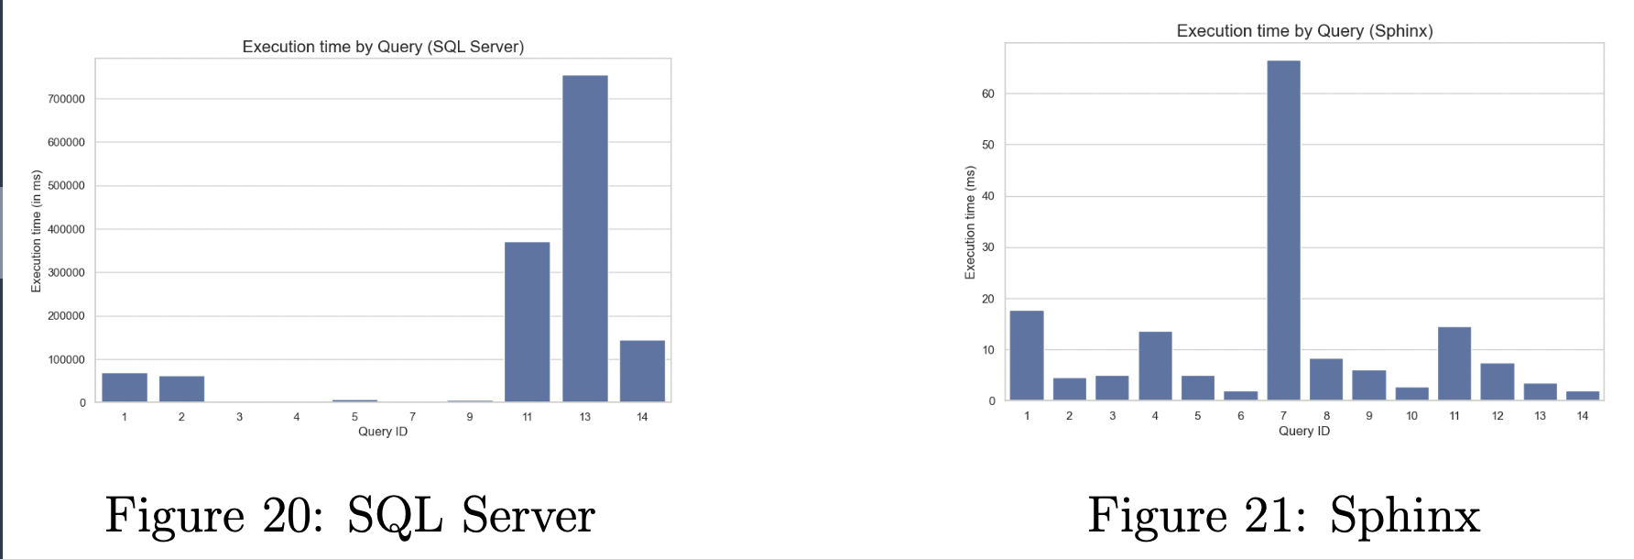
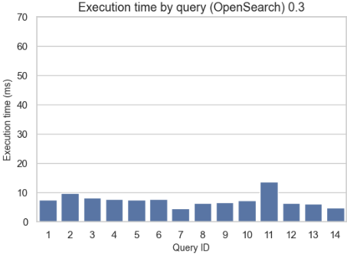
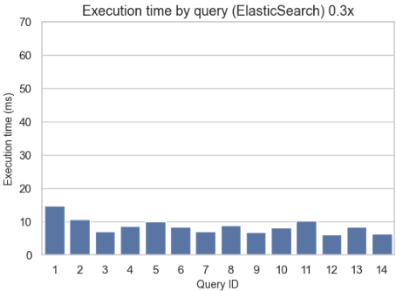
Application with relational - results
Scale factor : 0.33
Significant time difference between SQL
Server and Sphinx
SQL Server could not run all the queries
because some were
not applicable to relational databases.

Slide 57
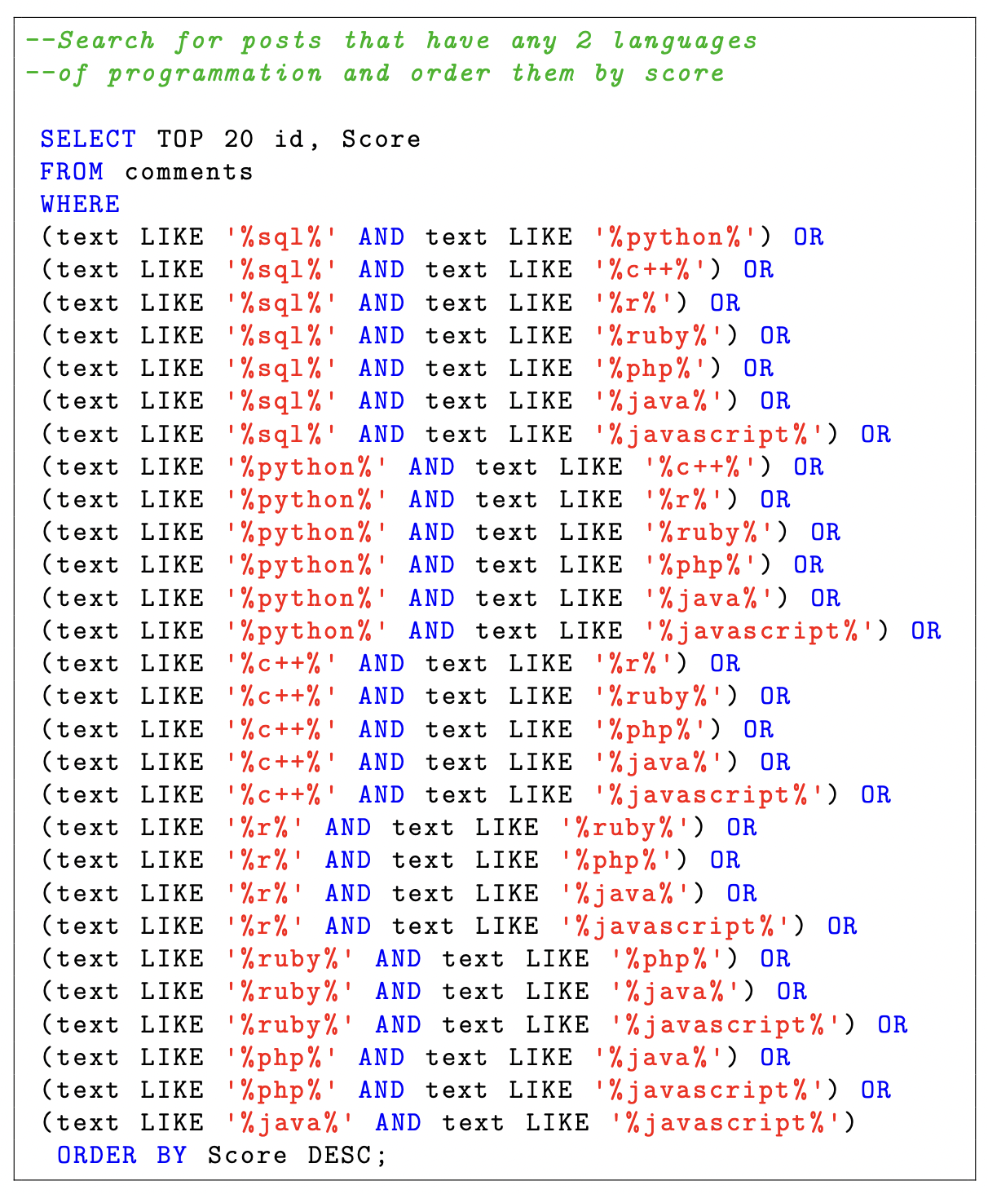
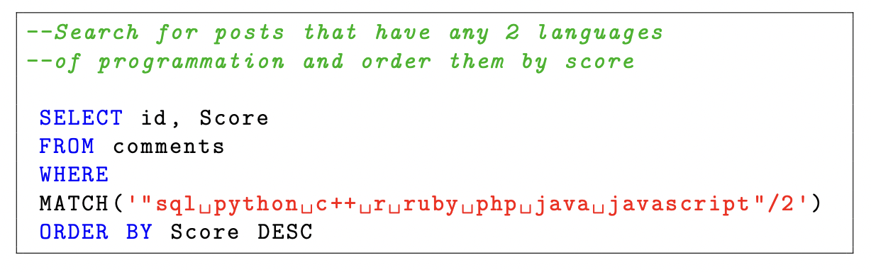
Application with relational – Query Example
Sphinx
SQL
Translation between Sphinx and SQL
Shows that SQL is not appropriate for
these types of queries
-> big difference between SQL times and other tools

Slide 58
Our application
Official Benchmarking Discussion
ElasticSearch vs OpenSearch
Ran the 18 queries again 50 times (actually 51 but we disregarded the first run for cache generalization)
Only in the three search engines, not SQL
Queries 15-18 were only used for the scale factor 1
Description and Database
Application with Relational
Our application

Slide 59
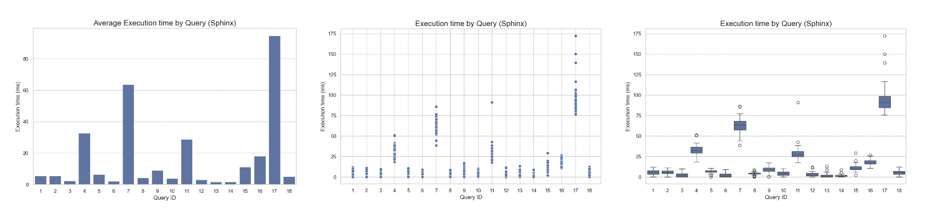
Our application- results for Sphinx
Sphinx Scale factor : 1
Closely resembles the one from the initial experiment
Variation in execution time is relatively minimal

Slide 60
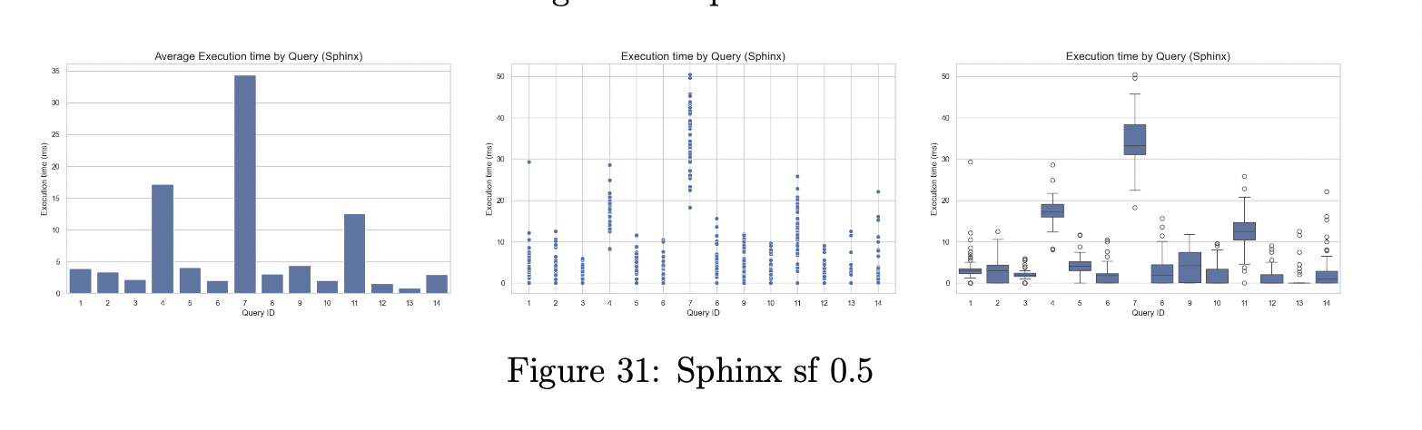
Our application- results for Sphinx
Sphinx Scale factor : 0.5
Times are considerably smaller in this second run
Pattern is the same, but times have decreased almost by half (linearity?)

Slide 61
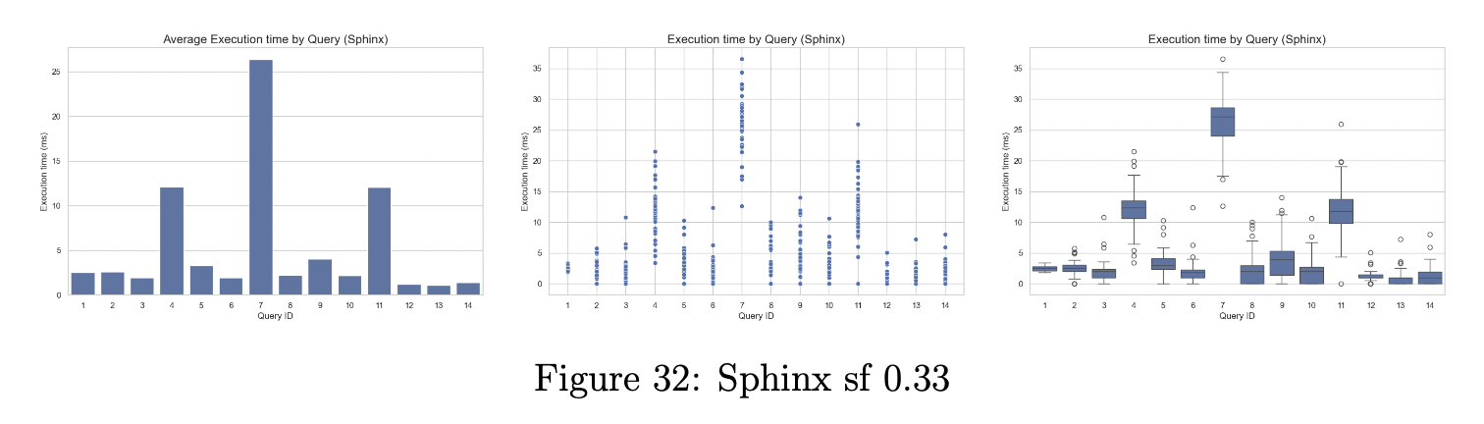
Our application- results for Sphinx
Sphinx Scale factor : 0.33
Linearity shows again
Time variance also seems to scale down with the scaling factor

Slide 62
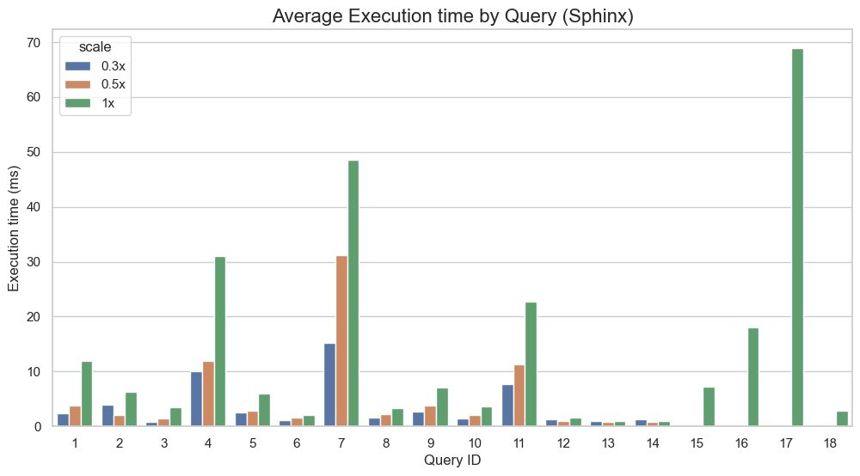
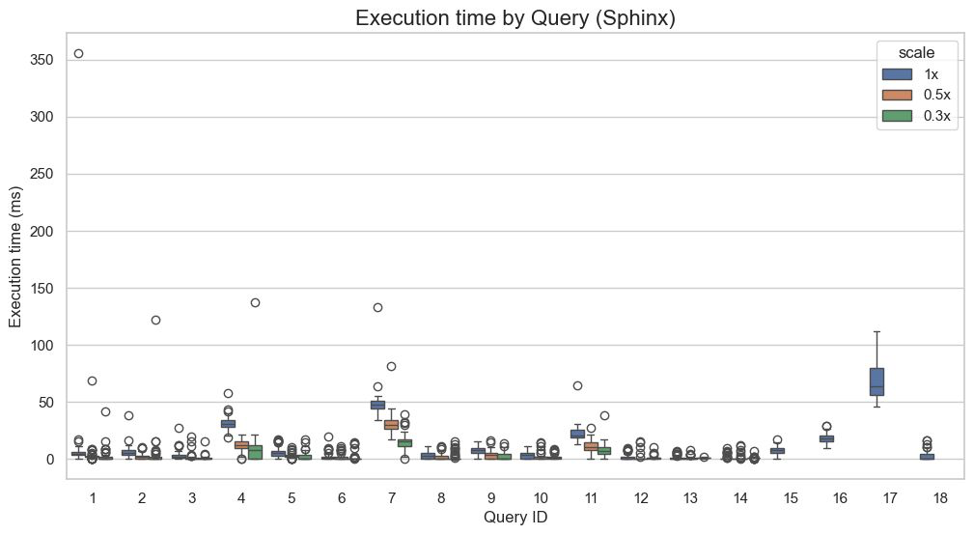
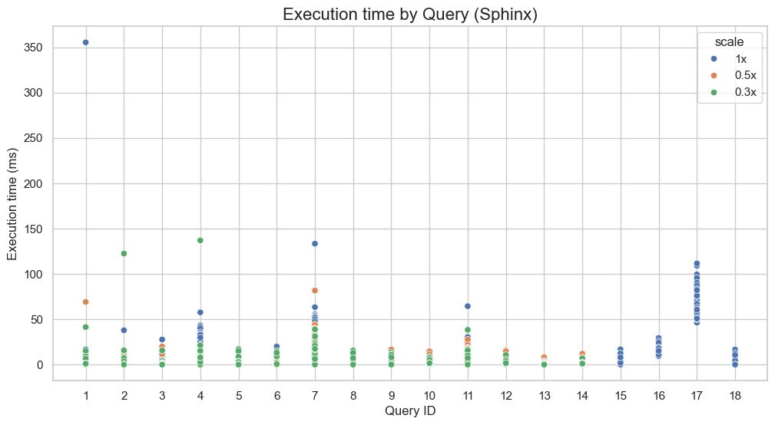
Our application – Sphinx Comparative results

Slide 63
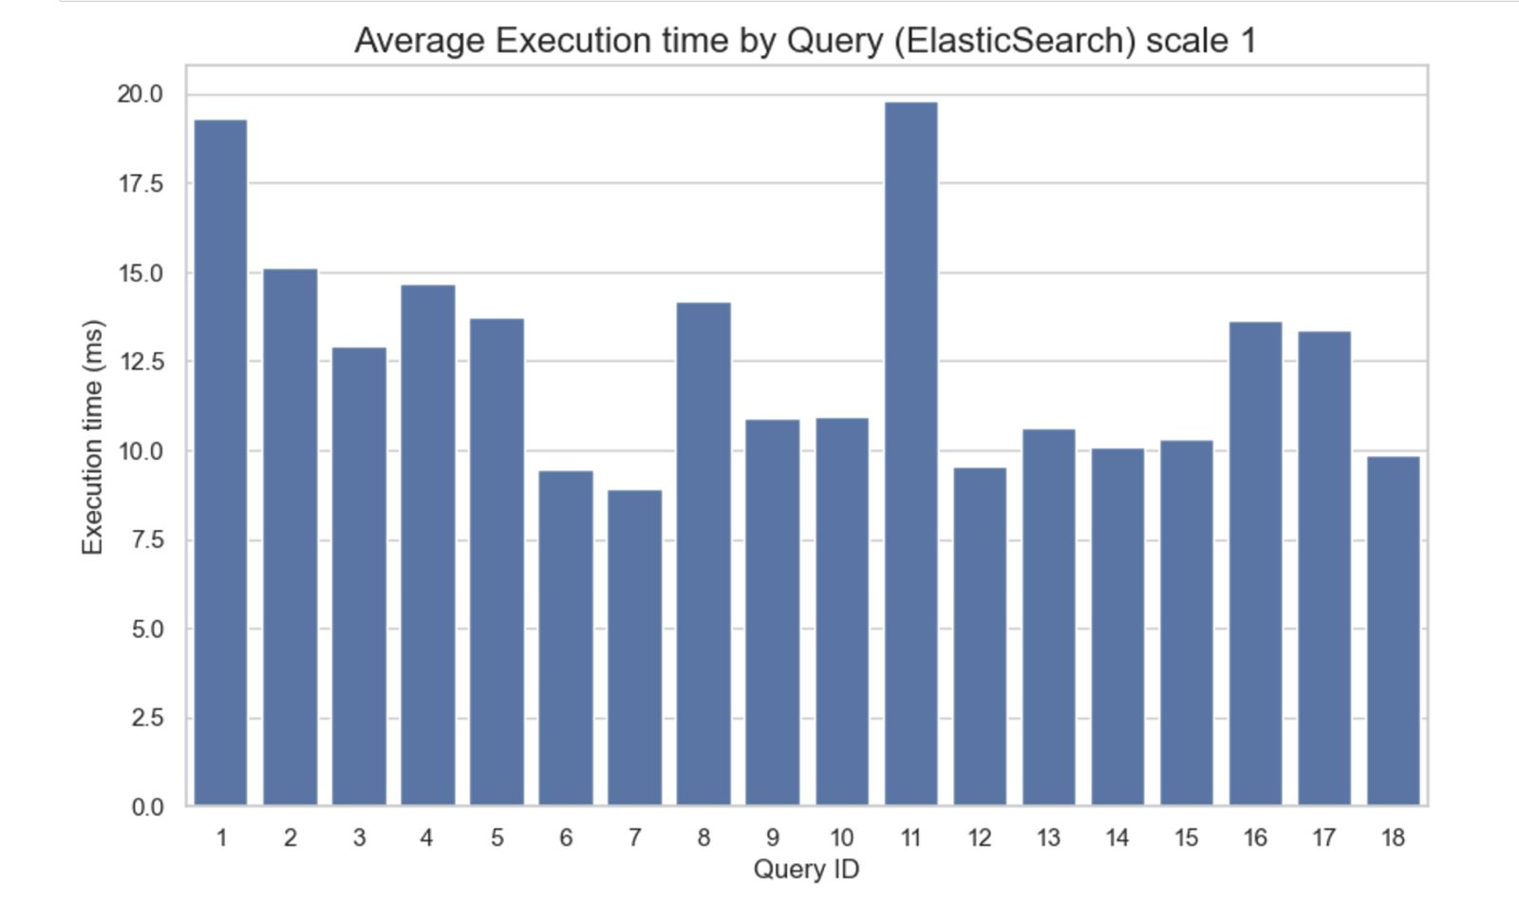
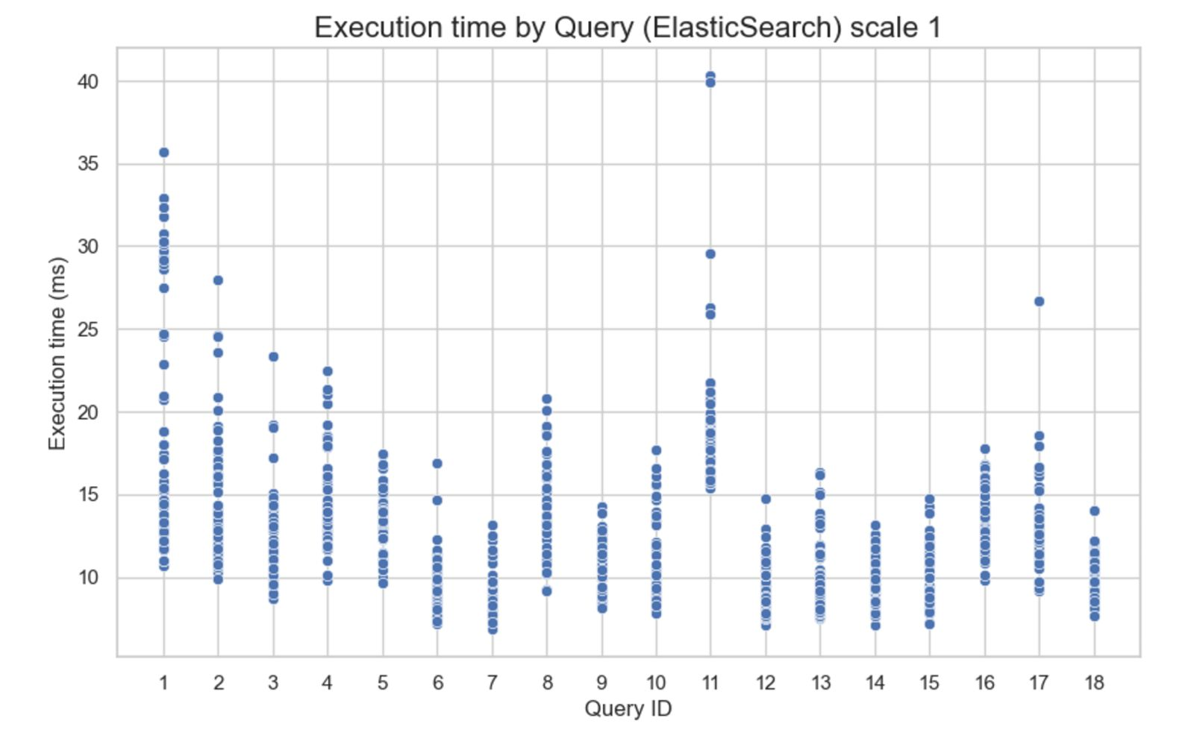
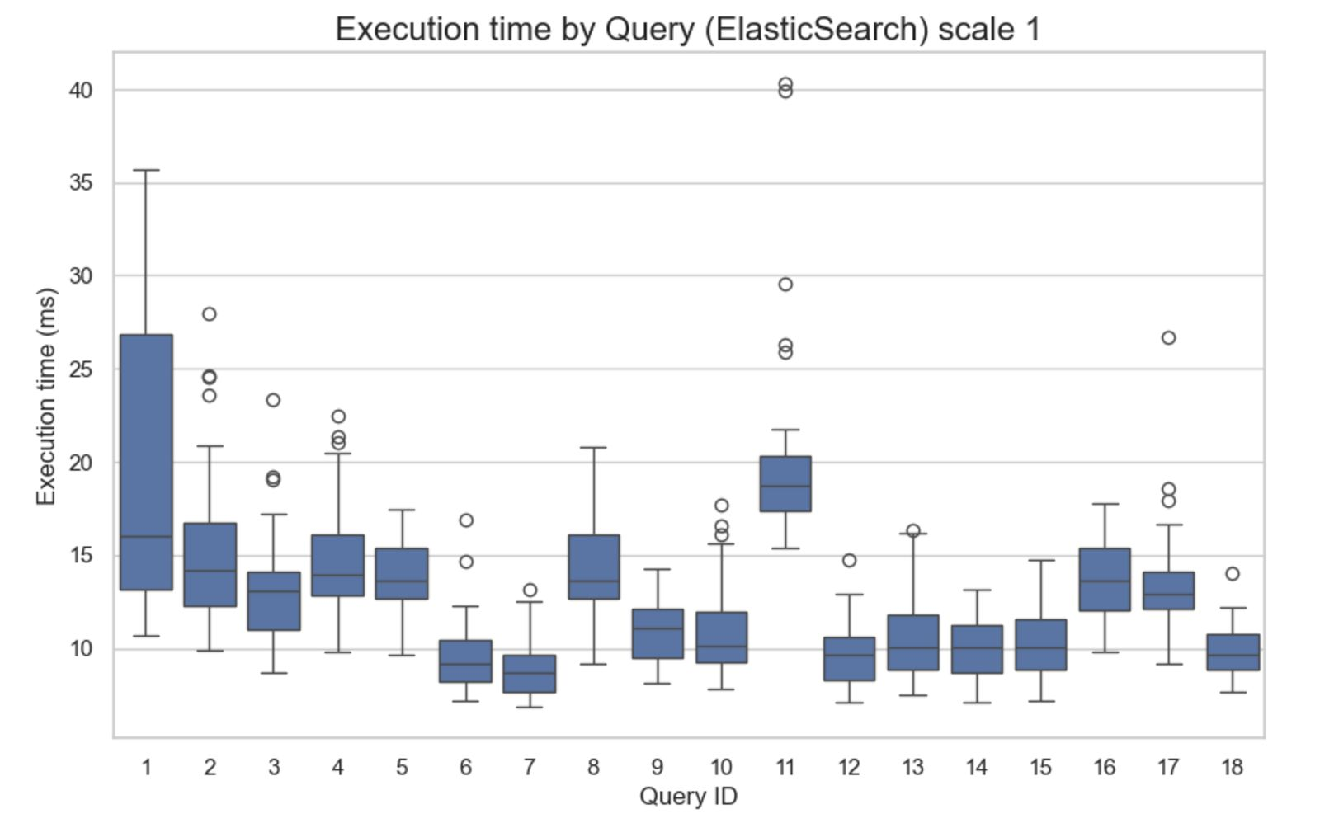
Our application – results for ElasticSearch
Results for Scale Factor 1:
ElasticSearch Scale factor : 1x
We can observe a high dispersion of the exécution time for all queries, with Query 11 reaching a max. average of almost 20 ms.

Slide 64
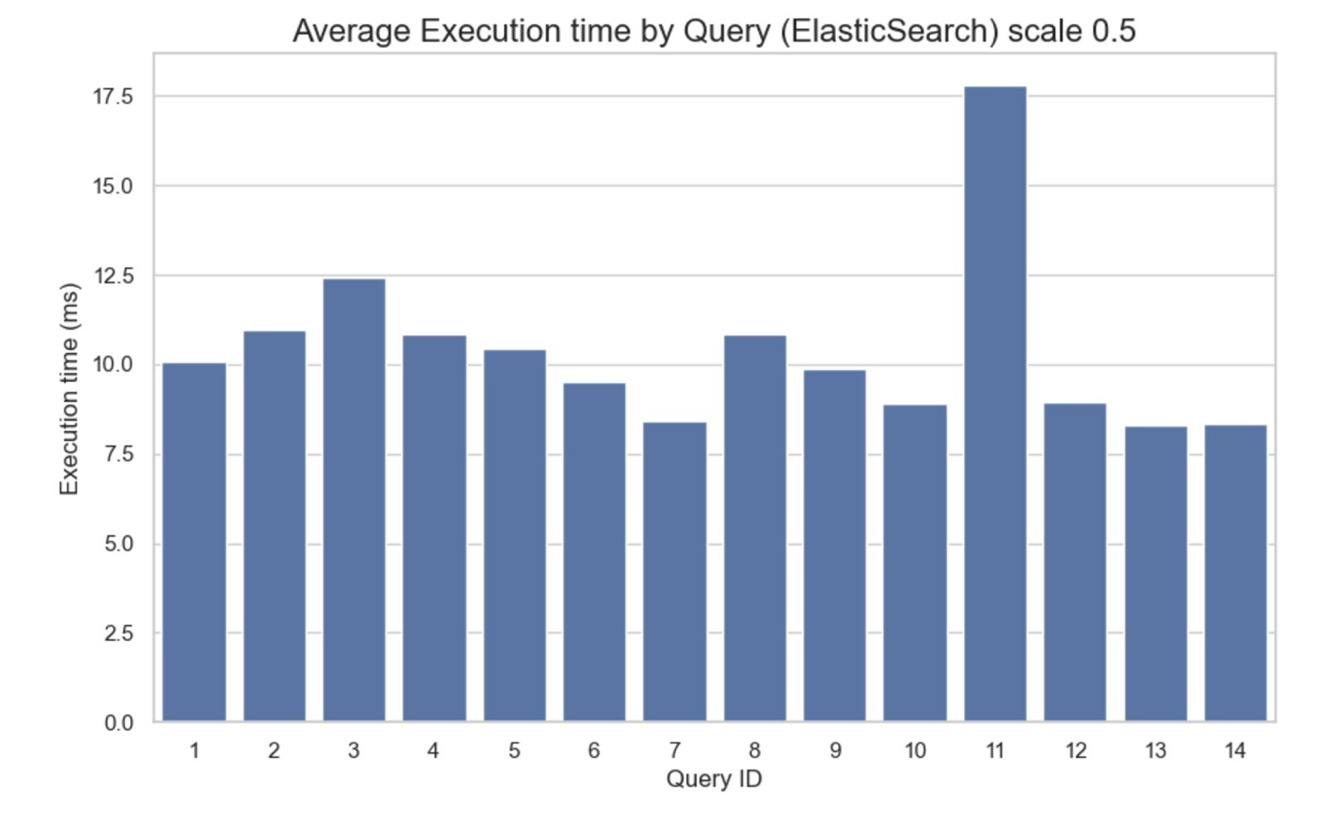
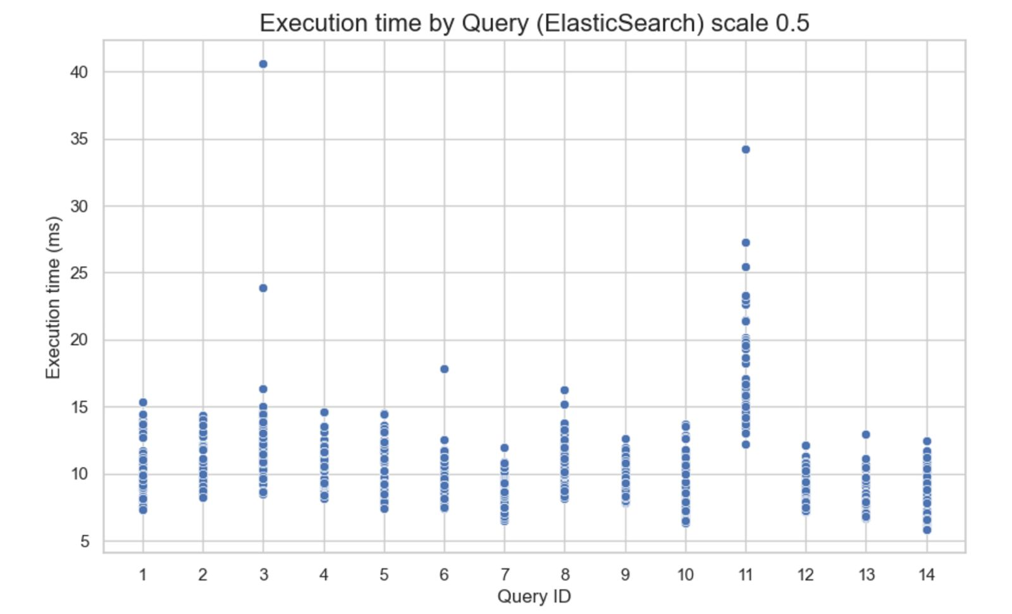
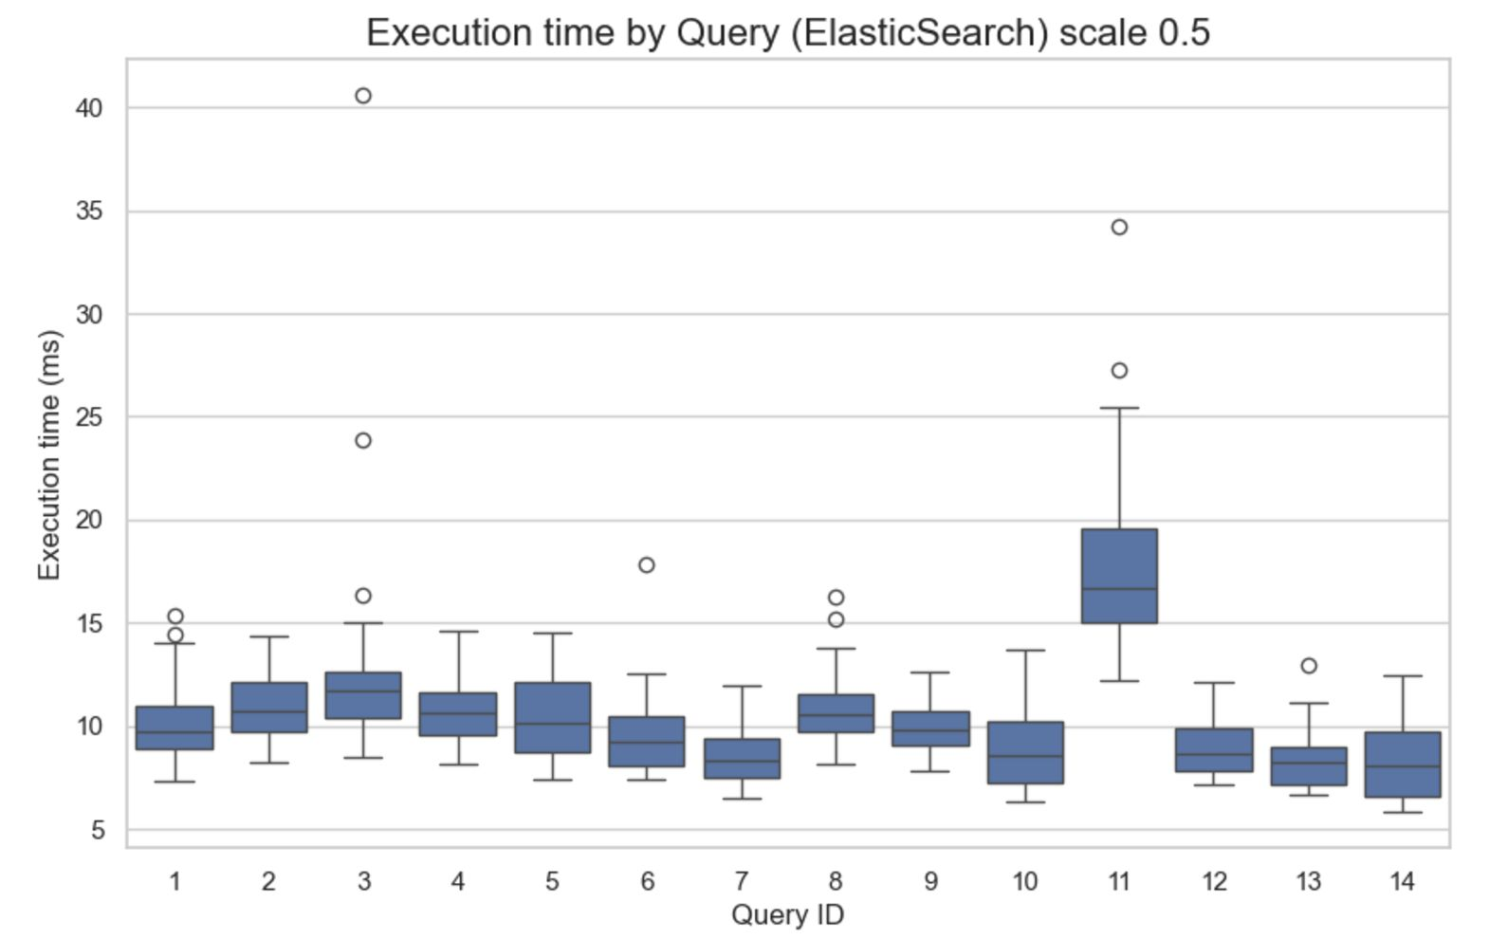
Our application – results for ElasticSearch
Results for Scale Factor 0.5:
ElasticSearch Scale factor : 0.5
The Average runtime becomes more even, with only Query 11 reaching a max. average runtime of 17.5 ms

Slide 65
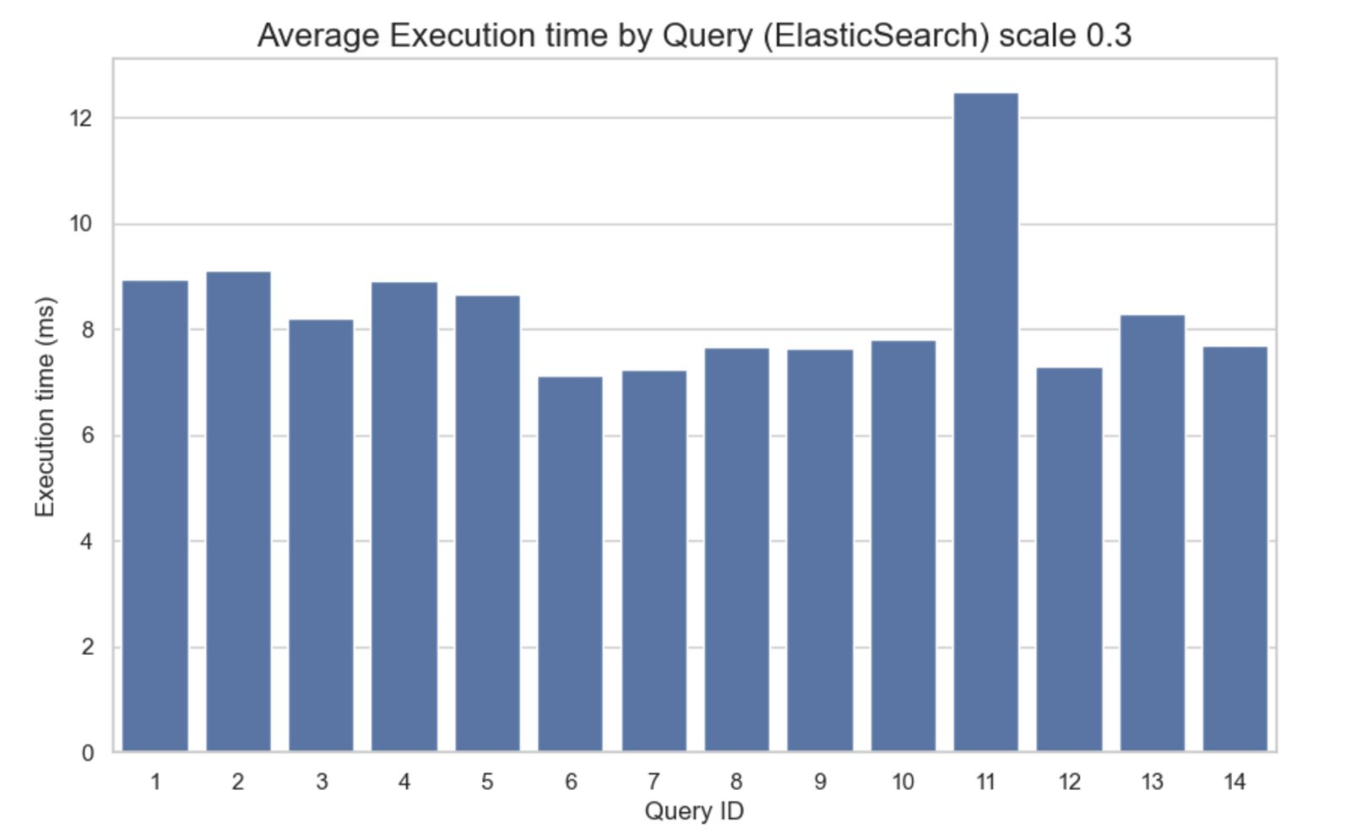
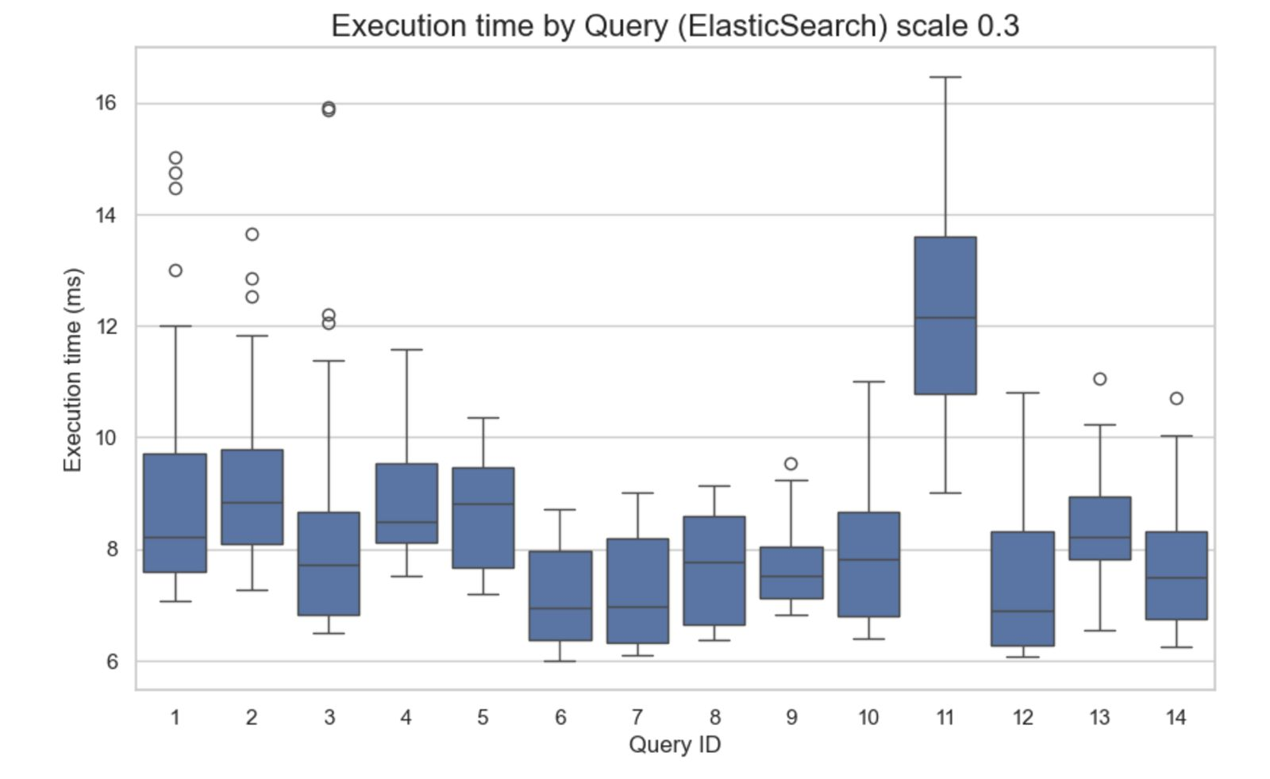
Our application – results for ElasticSearch
Results for Scale Factor 0.3:
ElasticSearch Scale factor : 0.3
Consistent average runtime of around 8 ms, with the same behaviour as for Scale 0.5

Slide 66
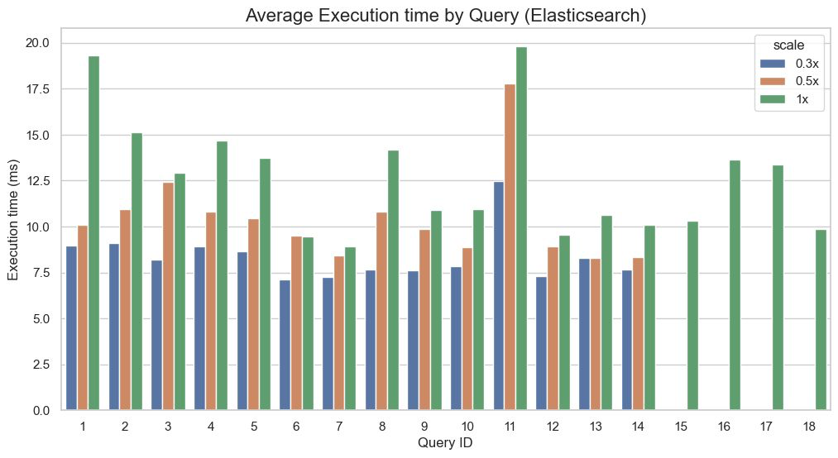
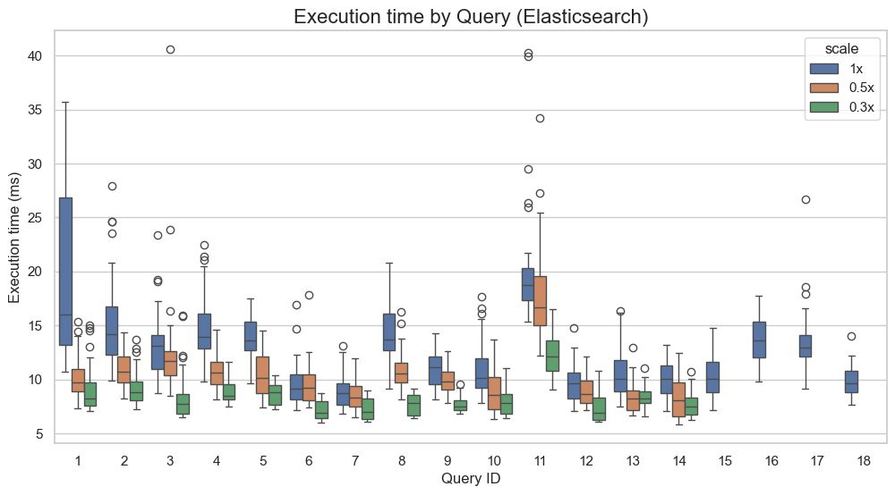
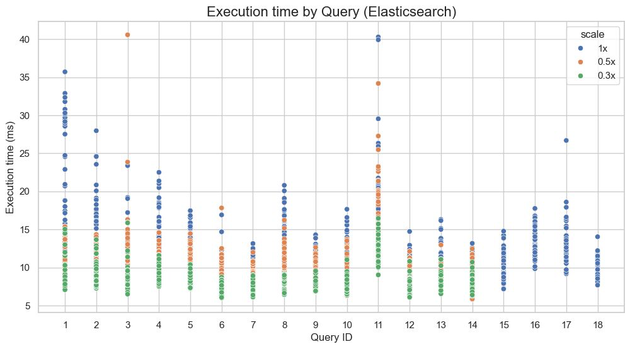
Our application – ElasticSearch Comparative results

Slide 67
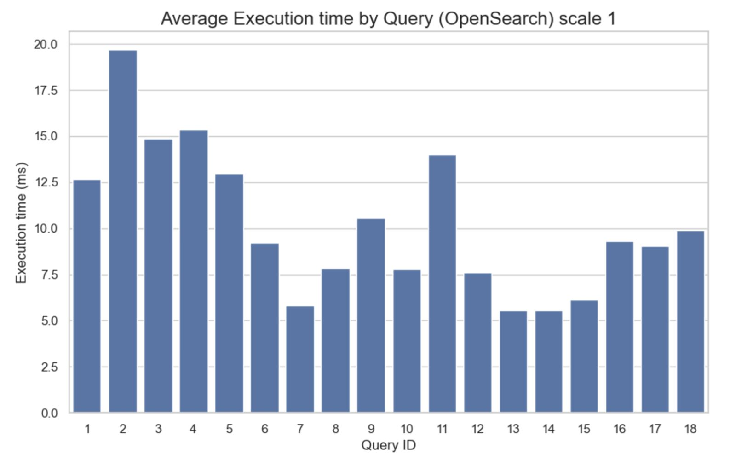
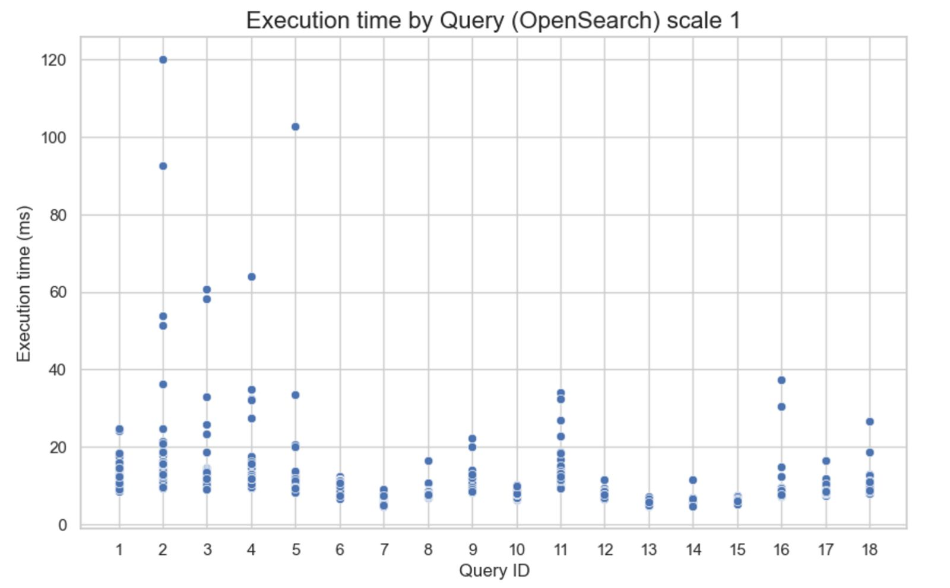
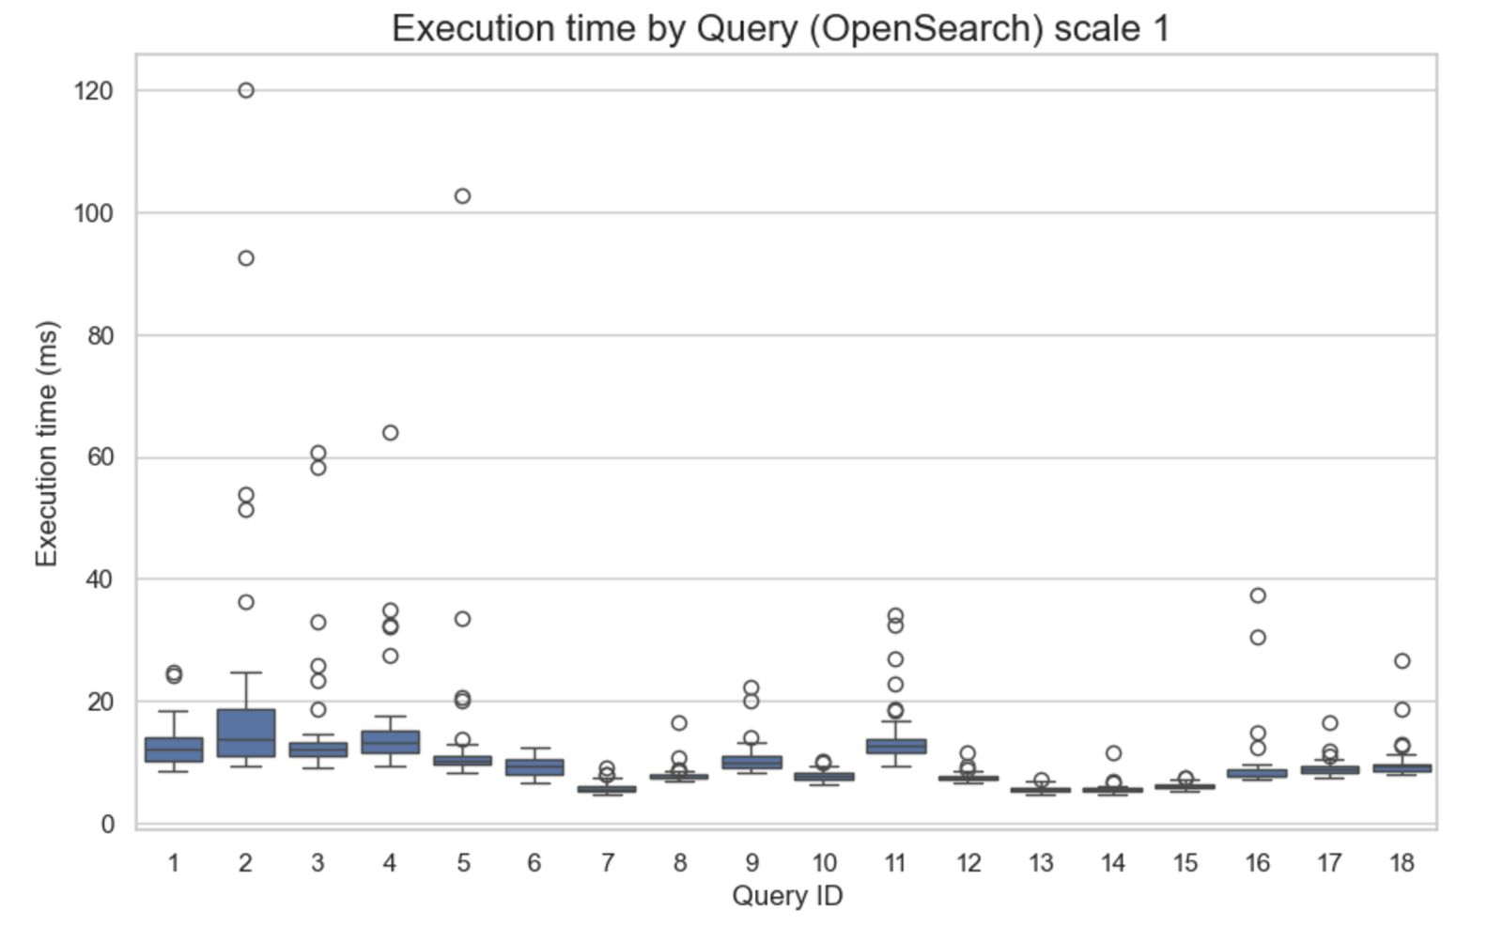

Our application – results for OpenSearch
Results for Scale Factor 1:
OpenSearch Scale factor : 1
Average runtimes go up to almost 20 ms due to single breakout events but mostly stay below 20 ms.

Slide 68
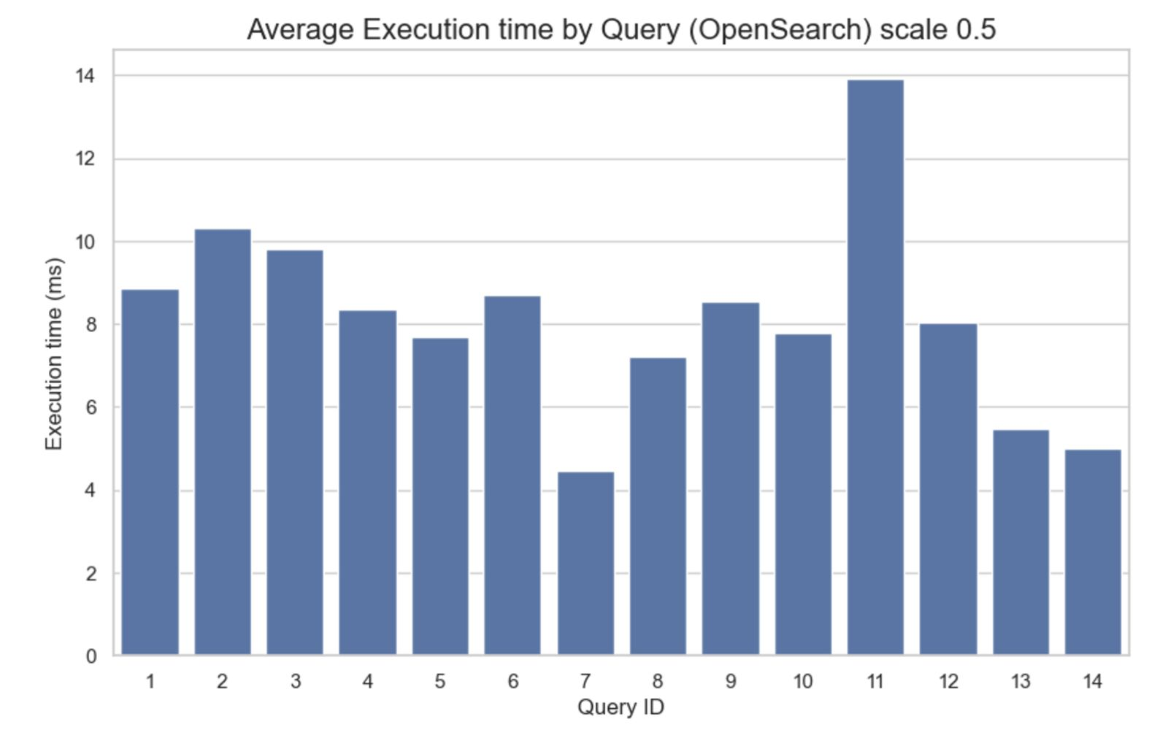
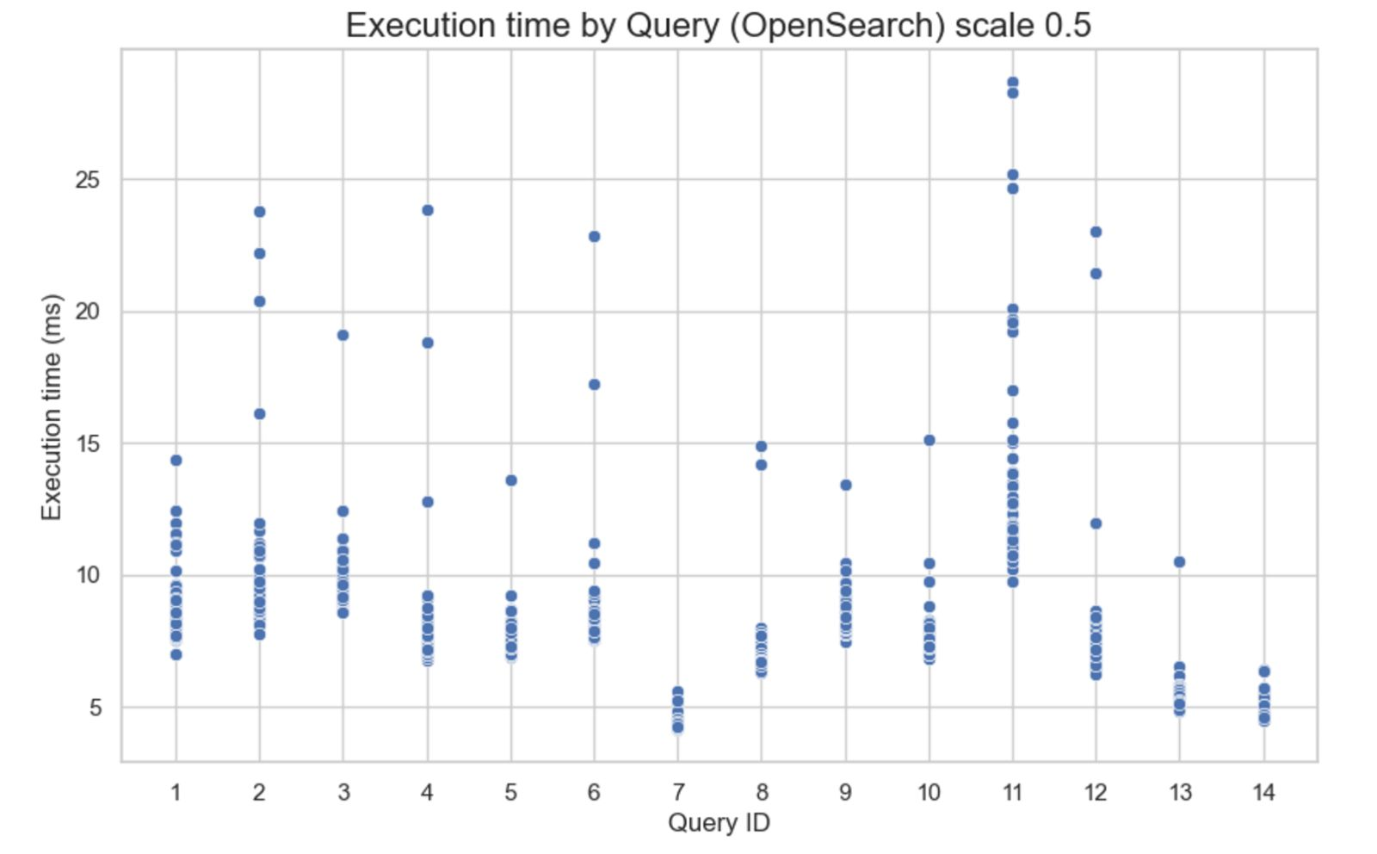
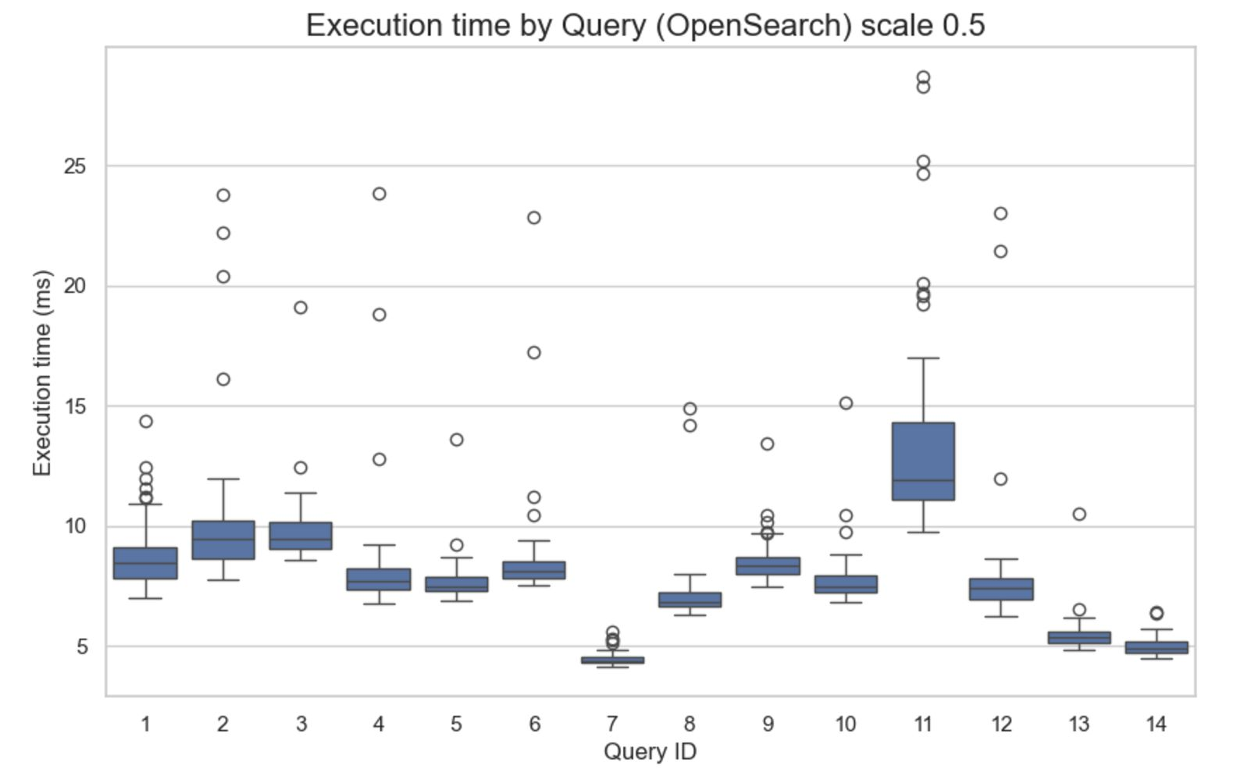
Our application – results for OpenSearch
Results for Scale Factor 0.5:
OpenSearch Scale factor : 0.3
Up to 27 ms for individual runs with an average runtime of between 4 and 14 ms

Slide 69





Our application– results for OpenSearch
Results for Scale Factor 0.3:
OpenSearch Scale factor : 0.3
Single breakout runtimes, but averagely around 10 ms per execution

Slide 70



Our application – Opensearch Comparative results

Slide 71
Semantic search with Elasticsearch
Enhanced posts’ index to support semantic matching
Focus on the title of the posts, creating index that both encodes the title as text and as vectors for semantic search
limit our dataset to 50% (expensive otherwise)

Slide 72


Semantic search with ElasticSearch – setup
Introduce a new field in Posts (Semantic_Title)
Dense vector of size 384
Model used: ”all-MiniLM-L6-v2”
set index to true
define distance function (cosine)
Model trained on a generic english corpus

Slide 73

Semantic search with ElasticSearch – setup
Experiment:
Run the same query using
first the syntactic matching (normal Title for Posts)
2. Same query with embedded semantic title field of our index
Defined a KNN query matching and
number of candidates to compare
Encode the query using the same model

Slide 74

Semantic search with ElasticSearch – results
- top 10 ranked results of both methods
Syntactic search : uninteresting results like ”Online Java Book
Semantic search : very interesting matches with the query such as”Resources for Python Programmer

Slide 75
Interesting Research

Slide 76
Interesting research – Use Case I
Optimizing Retrieval-Augmented Generation (RAG) with Search Engines
LLMs are powerful at understanding and generating text but face some challenges:
Accessing up-to-date or domain specific knowledge.
Answering complex queries with diverse and relevant results.
Introducing ElasticSearch with its ability to understand semantics would offer several benefits:
Improved Retrieval Speed due to inverted index structure
Enhanced Relevance and Diversity of Search Results due to adaptive weight distribution based on the users needs
Scalability – Adjustable to developments of data sources or business needs

Slide 77

Interesting research – Use Case I
Optimizing Retrieval-Augmented Generation (RAG) with Search Engines – Experiment
To support the proposed solution using Elastic Search an Experiment was set up, using the Stanford Question Answering Dataset (SQuAD).
The results show a clear improvement in performance using search engine technology.

Slide 78
Interesting research – Use Case II
Digitalisation of Local Geographic Information Storing and Querying using search engines
The Ottawa Resource Collection contains 3000+ documents about the region of Ottawa with the following challenges:
Scalability with the amount of documents
Missing geographical context
Cost and hardware constraints
Providing easy to understand output
Introducing ElasticSearch with its ability to understand semantics would offer several benefits:
Great Searchability due to the creation a full-text searchable repository by ElasticSearch
Providing neighborhood or landmark context due to semantic understanding
Structured, JSON-based results with highlighted text and metadata (e.g. title, page number, geo-coordinates)

Slide 79

Thank you for your attention!
P A R T 0 1
Learn more at:
https://github.com/Carda01/SearchEngines_benchmark

